Slide 1

  Mobility for Livable and Sustainable Communities:
  Tompkins County, NY
Dwight Mengel, Chief Transportation Planner, DSS
CTAA Mobility Management Conference, Indianapolis, IN
June 6, 2011

Slide 2
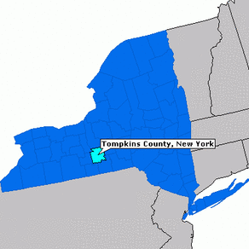




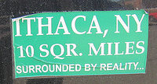

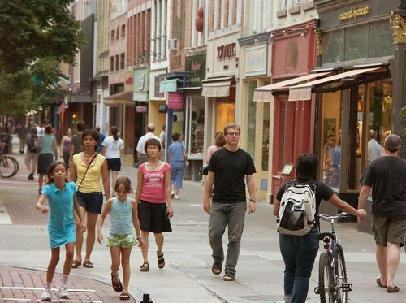

Tompkins County, NY

Slide 3
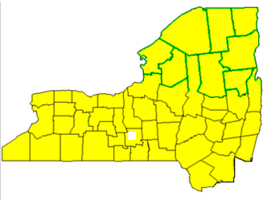
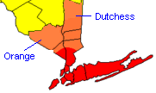
Upstate NY
Upstate NY
Upstate NY
6.3 million people out of 19.4 million pop. (2010 Census).
3% of New York State’s public transit ridership.
Downstate NY
Notes:
Upstate is north of Orange & Dutchess. If it were an independent state, Upstate NY would be ranked 13th by population.
Upstate: 74 million passenger-trips
Downstate: 2.6 billion passengers-trips

Slide 4
Travel to Work (2006-08)
 | Drove Alone | Sustainable Mobility
New York State | 54% | 46%
Tompkins County | 60% | 40%
Upstate NY Urban Areas | 79% | 21%
Notes:
Sustainable mobility includes all modes other than drive alone.

Slide 5
Means of Transportation to Work in Tompkins County
 | Tompkins County | Upstate NY Urban Areas
Total Workers: | 60,733 | 2,617,776
Drive alone | 60% | 79%
Public Transportation | 6.4% | 2.4%
Carpool / Rideshare | 11.6% | 9%
Walk | 14% | 4%
Work at home | 5.3% | 4%
Bicycle, Taxicab, Motorcycle, Other | 2.3% | 1%
American Community Survey 2006-08 3-Year Data Set , Data Table C08601

Slide 6
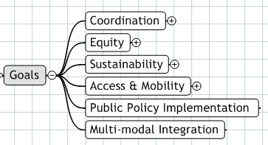
Mobility Management

Slide 7
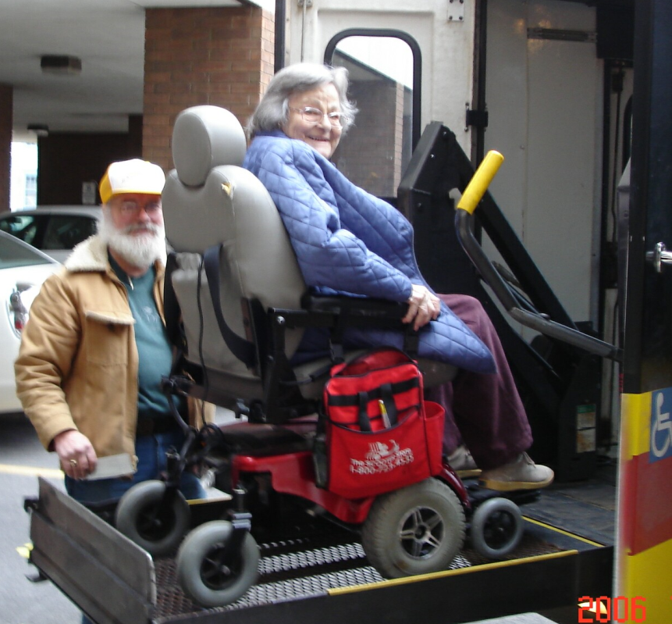
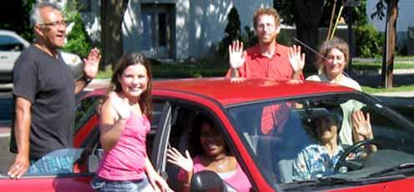
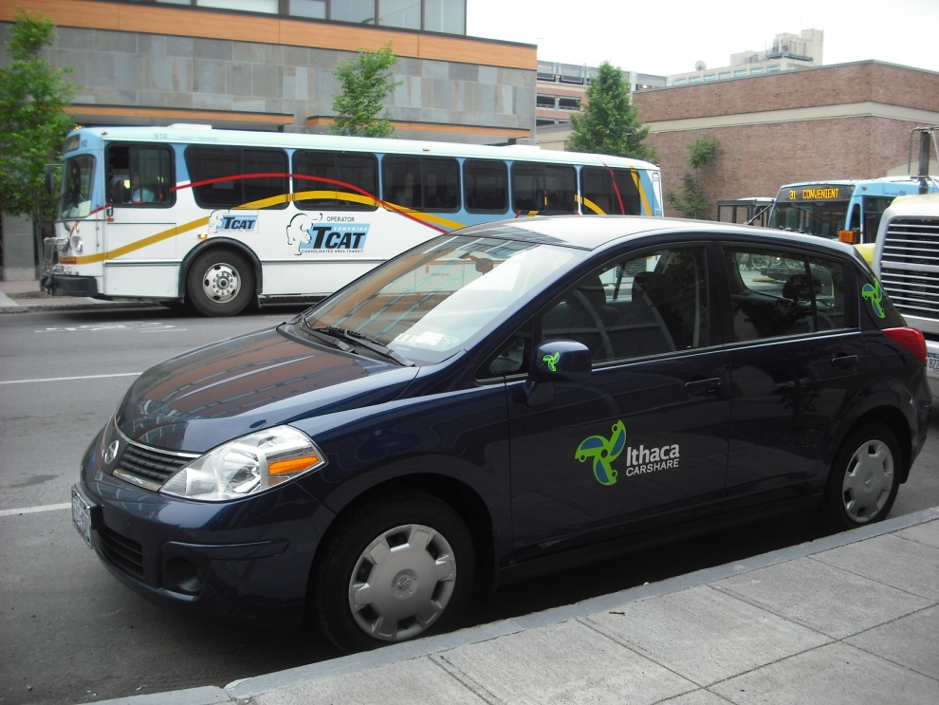
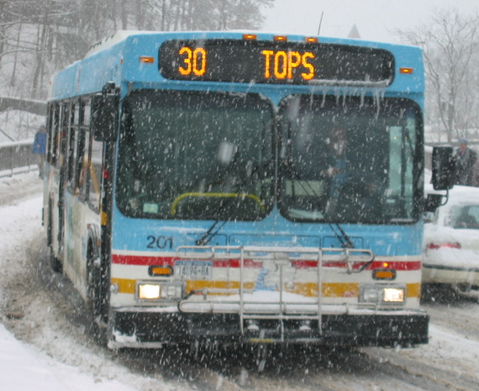
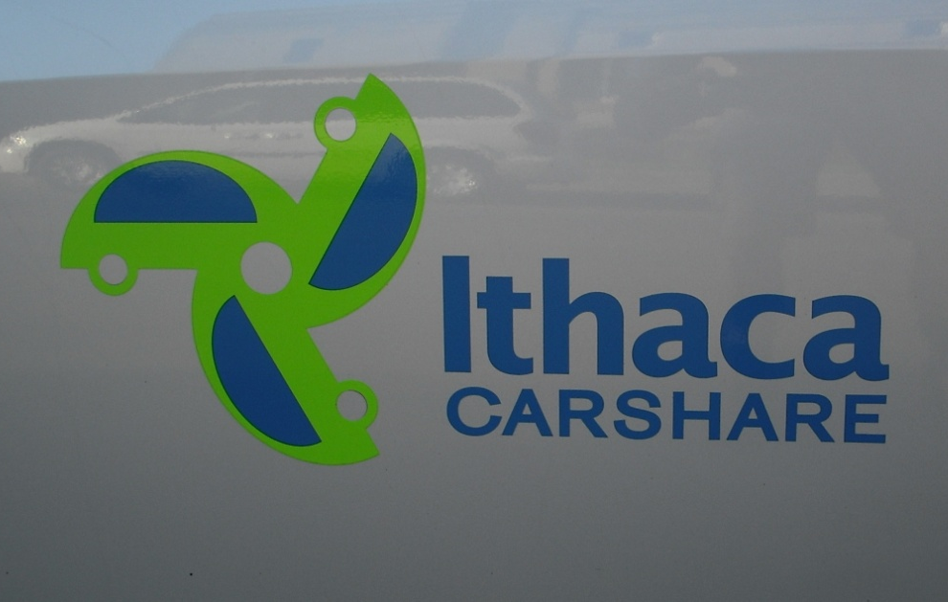

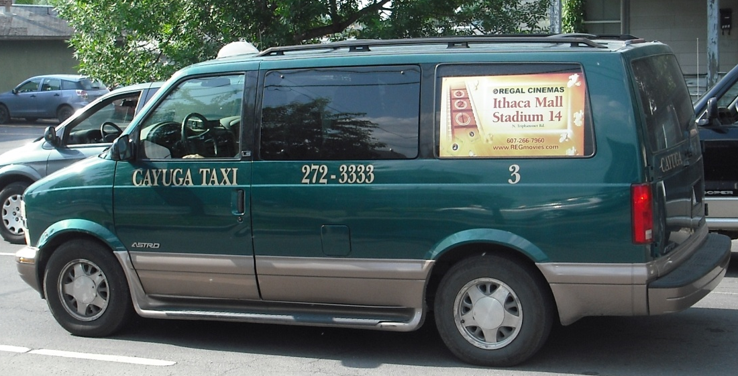

Family of Services
Bus, Taxi, Vans, ADA, Volunteer Drivers, Vouchers, Ridesharing, Van-pool, Bicycles, Car-share, Car Rental, Guaranteed Ride, Way2Go.
Notes:
7

Slide 8
Family of Services - Supports
Targeted user side subsidies
Taxi vouchers
Working Families Supports
Carshare Easy Access Plan
Volunteer Driver Programs
Guaranteed Ride

Slide 9
2011-12 Action Plan
Way2Go
  Add coordinated community travel training (2011)
  Add retiring from driving for seniors (2011)
Regional Mobility Plan
  Start July 2011
ITNEverywhere Development Project
  Start May 2011
Neighborhood Greenways (Bike Boulevards)
  Begin public process in City 2012
Notes:
Connect with DSS. Transit operators need to reinvent themselves to be a leader or partner in mobility management.

Slide 10
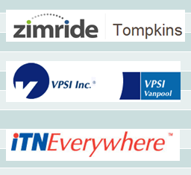

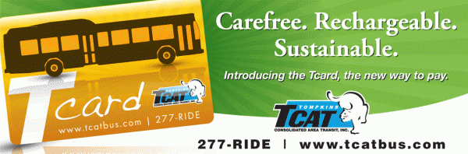


Rideshare
Services | Supports

Slide 11
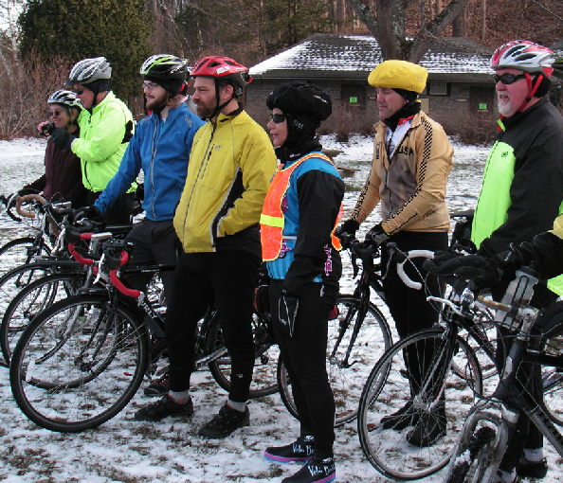
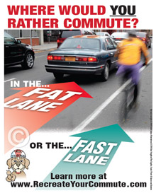
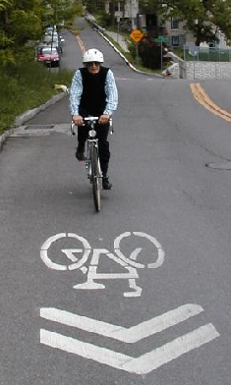

Bicycling

Slide 12
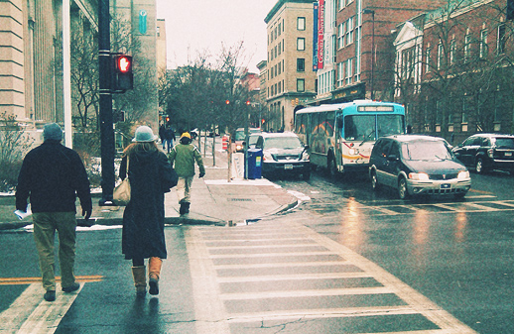
MM Strategy
Use Mobility Management as a change catalyst.
Set Sustainable Mobility Goals and measure.
Expand Family of Services regionally.
Create a business plan for selling mobility solutions to customers.

Slide 13
Thank You
Dwight Mengel,
Chief Transportation Planner,
Tompkins County DSS
(607) 274-5605
dwight.mengel@dfa.state.ny.us
tccordinatedplan.weebly.com
mobilitymanager.weebly.com
Sustainable Tompkins, etc.
way2goinfo.org

