Slide 1
Coordinated Mobility
A Transportation Management Solution
Notes:
The instructor should identify the concepts of coordinated mobility and mobility management as a reoccurring theme throughout the course.

Slide 2
Instructor
James McLary
39 years of transportation management and planning experience
With NTI for 6 years; also teaches:
Understanding the ADA
Paratransit Management and Operations
Strong advocate of resource management
Notes:
Provide a brief background of the instructor, including relevant experience and qualifications.

Slide 3
Instructor
Jana Hunkler Brule’
5 years of transportation management experience
18 years of public service
Consensus builder and community catalyst
Notes:
Provide a brief background of the instructor, including relevant experience and qualifications.

Slide 4
Course Goal
The goal of this course is to help mobility, human service, and transit professionals examine creative approaches to resolve fragmented and/or duplicative transportation systems in order to create a more seamless and cost-efficient network with a customer-focused mindset.
Notes:
This is not a top-down process – it’s bottoms-up. Think about the customers’ needs.

Slide 5
Course Objectives
Introduce the concept of mobility management and its application to transportation operations at the community level
Identify funding resources available for implementing and operating mobility management programs
Describe how to develop the Coordinated Public Transit and Human Service Transportation Plan “Coordinated Plan”
Notes:
All participants should be prepared to return to their appropriate organization and begin practicing mobility management.

Slide 6
Course Objectives
Identify the necessary tools and resources to effectively implement a mobility management program
Present case studies of successful mobility management models
Discuss the skills of a mobility manager

Slide 7
Course Outline
Module 1: Defining Mobility Management
Module 2: Making the Shift – A New Paradigm
Module 3: Coordinated Public Transit and Human Service Transportation Plan – The “Coordinated Plan”
Module 4: Tools, Strategies, and Technology
Module 5: Case Studies
Module 6: The Mobility Manager and Mobility Management – Putting It All Together
Notes:
The instructor should explain how the modules, discussions, and learning activities will work together to provide a well-rounded learning experience. Emphasize the interactive nature of the course and encourage discussions and questions.

Slide 8
Participant Workbook
Course slides
Reference materials
Handouts
Resource CD – includes PowerPoint presentation
Evaluation – extremely important
Written evaluations
Direct feedback with development team

Slide 9
Participant Introductions
Name, organization, role
Experience with mobility management?
What are you hoping to learn?
Notes:
The goal of this slide is to make participants feel welcome and get to know their fellow participants, determine the participants’ general level of familiarity with the course subject matter, and discover what participants wish to accomplish during the course.
Instructors will:
Introduce themselves.
Ask participants to introduce themselves, mention the extent of their previous experience with mobility management, share their expectations, and volunteer specific questions or issues they want to cover during the course.
Write participants’ objectives/expectations on a flip chart.

Slide 10
Ground Rules
Please turn off cell phones
Please return from breaks and lunch on time
Stay on task during learning activities
Questions and discussions are encouraged

Slide 11
Module 1
Defining Mobility Management

Slide 12
Learning Objectives
List the continuum of transportation service options “Family of Services”
Define the mobility management concept and functions
Discuss the role of coordination in mobility management
Notes:
Mobility management is a management tool that maximizes resources through the process of collaboration and coordination. But coordination is just a piece of mobility management.
There are many on-going efforts, but few have taken the idea to the full extent. Some examples include:
Florida’s Community Transportation Coordinators
Washington State Regional Brokerages
The change taking place includes changes in attitudes, perspectives, skills, and resources.

Slide 13
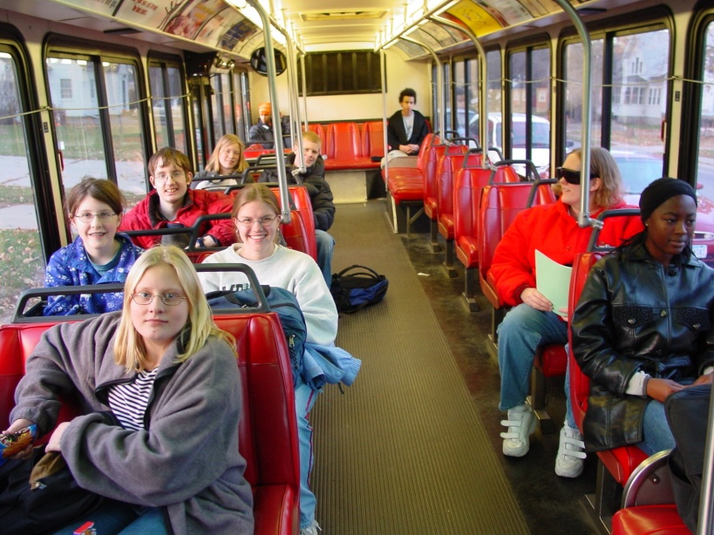
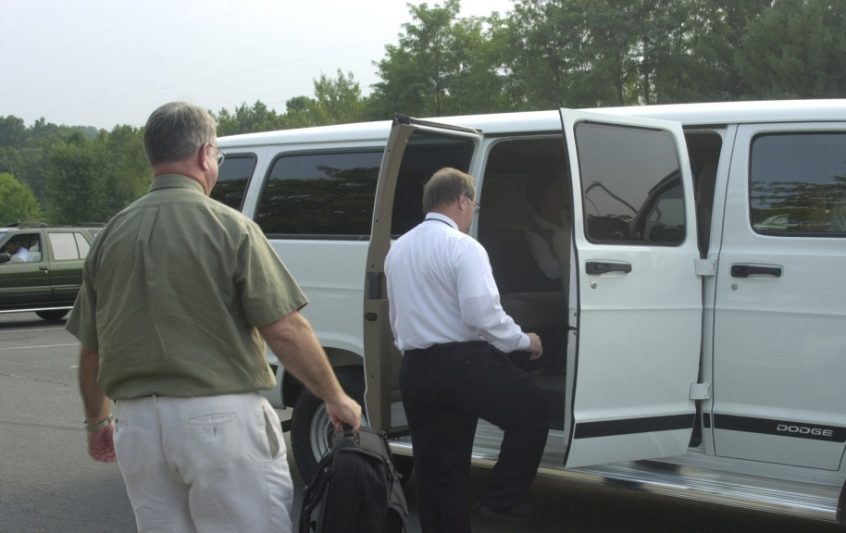
Current Concept
Continuum of transportation service options
“Family of Services”
Coordinate existing transportation resources
Notes:
The continuum of service options includes private vehicles to commuter rail (i.e., “Family of Services”). This is shown in the next slide.
One piece of the mobility management program is the coordination of existing resources. Coordination has existed for over 30 years, and these efforts can be considered the first step in mobility management.
Before you coordinate services, you have to know what services are available and where they are available. This is usually found in the “Coordinated Plan,” which is discussed later.

Slide 14
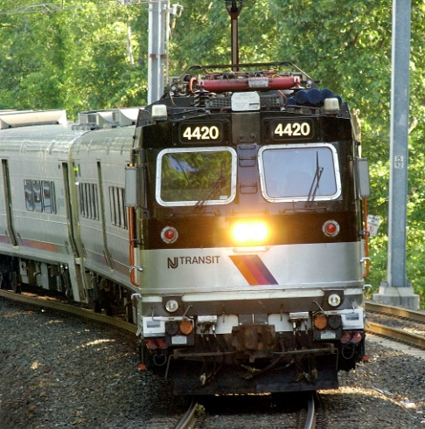
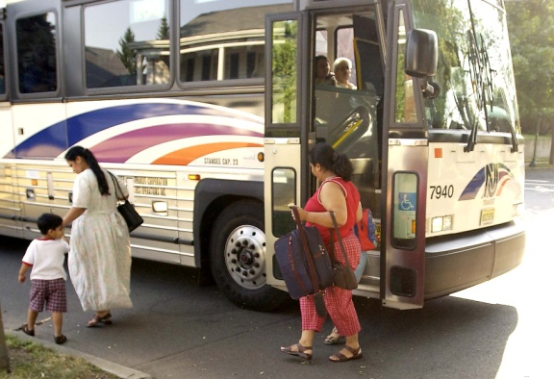
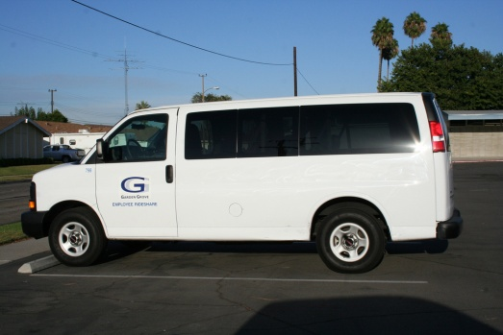
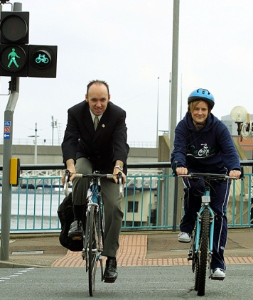
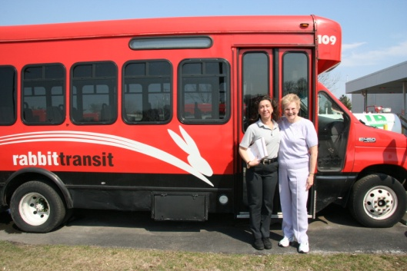
Family of Services
Rail
Bus, Taxi, Vans, ADA, Volunteers, Vouchers, Ridesharing, Bicycles, Pedestrians
Private Automobile
Notes:
The family of service options include:
Private vehicle to commuter rail. The private auto offers the most flexibility, but the lowest efficiency. How do you double the efficiency of an automobile? Put 2 people in it (carpool!).
Taxis, buses, and light rail offer medium flexibility, but greater efficiency.
The least flexible mode is heavy rail, but also the most efficient.
Different communities will use different parts of the pyramid. Rural areas will not use heavy rail, as this is generally reserved for urban areas. Although, some urban metropolises (e.g., Washington, DC) have commuter rail going to the rural areas.
The middle section of the triangle is the heart of mobility management.

Slide 15
Mobility Management Concept
Multiple providers enable service choices
Disaggregated vs. aggregated model
Mobility management functions
Service development
System management
See Appendix for Doug Bernie’s Mobility Management Concept Papers
Notes:
The mobility management plan assumes there will be multiple providers (travel agents), including private, private-non-profit, public, and institutional providers. The mobility manager must be a service advocate and look for ways to enhance service delivery.
A disaggregated model still exists today – agencies are not aggregated (i.e., working together). The key to an aggregated model is for organizations to communicate, cooperate, and consolidate (the 3 Cs).
Mobility management functions include both service development and system management. The mobility manager does not have to be, and in many respects it would be better if they were not, service providers.

Slide 16
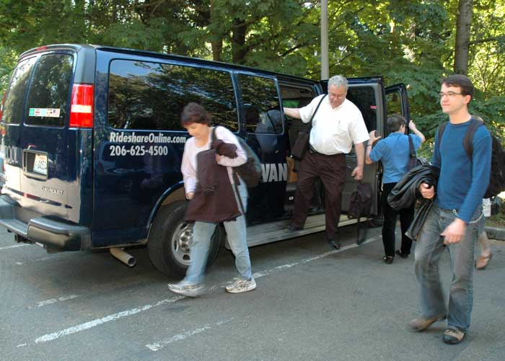
Mobility Management Concept
Service development
Vehicles
Movement of people
System management
Land use
TOD, livable communities
Green
Notes:
Service development – Includes the identification of resources, public, private, and non-profit. This also includes the coordination piece and involves the movement of people. Examples include one-stop call centers and the family of services.
System management – This is the demand management and land use applications. Livable communities (we will discuss later) is a major part of mobility management. The “greening” of our society is supported by mobility management.

Slide 17
Service Development
One stop call centers
Information and referral
Family of Services
Coordination of programs and agencies
United We Ride
Notes:
The service development aspect of mobility management is the movement of people. One stop call centers can be full brokers or simply information and referral (e.g., 211, 511, Aging and Disability Resource Center (ADRC)). Service development includes the Family of Services (volunteers, taxi vouchers, ride sharing, fixed route, etc.), and is concerned primarily with the coordination of these services. United We Ride is focused on human service coordination.

Slide 18
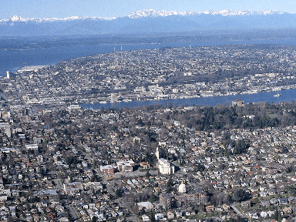
System Management
Planning
Transportation – regional
Land use – livable communities
Demand Management
HOV – multiple riders
HOT – pay toll for roads without congestion
Congestion pricing – pay fee to travel during peak hours
Regulatory barriers
Telecommuting, flex hours
Notes:
During the planning process, which comes first – land use or transportation?
Land use planning and transportation planning should be linked to form a coordinated community planning effort. The two different planning functions are often separate and independent. The goal of mobility planning is to closely link the two planning efforts. For example, when developing a shopping center it’s important to ALSO consider the development of a transit route through the area before the shops open.

Slide 19
Macro Planning
Family of Services – match demand with existing resources
Use of existing infrastructure
Lower density – more difficult for mobility to be effective
Higher density – easier to serve with mobility options
Notes:
Mobility management includes all modes of transportation. The goal is to match demand with existing resources. These resources might be transit agencies, human service agencies, cities, states, private foundations, volunteer programs, etc.
Macro planning includes the use of existing infrastructure, not the creation of new bureaucracies. That does not preclude new organizations, but encourages the use of existing infrastructure first. It includes the use of all modes and all services.
Discuss the difference in the land use designs and the requirements for transportation. The lower the density the more difficult it is for transportation to be effective. The higher density in Europe is easier to serve with transportation options.
**Note: The mobility management concept includes both macro (operations) and micro (individual needs) planning.

Slide 20
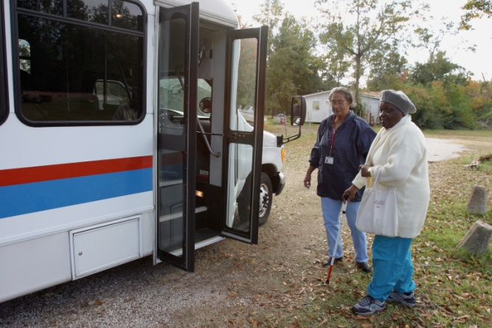
Micro Planning
Individual access
Individual choice
Individual function
Mobility
Availability of service
Demographic changes
Different environments
Suburban, urban, and ex-urban
Notes:
An important aspect of mobility management is the freedom of the individual to chose among various options. The individual may want to take a certain type of transportation, and the mobility manager needs to know so they can match or offer options. Individual choice is very important. The bottom line is to strive for better mobility by utilizing existing resources and making the systems more efficient and effective.
Each individual has different environments and therefore different availability of services. It has been reported that over 40% of all counties in the United States have no access to public transportation. In addition, different individuals have varying degrees of mobility. Examples include: 1) the senior population becomes less agile with age, and 2) many people with disabilities have less mobility than ambulatory individuals. Mobility management should account for all people.
**Note: By 2025, the senior population will be 25%.

Slide 21
Vision
Enhance customer access to transportation services
Provide an interface between disciplines at the community level
Focus on customer service
What is your definition of mobility management?
Notes:
Everyone should know that customer service is the prerequisite to successful service. The agencies must keep their customers in mind first.
Interactivity – Ask: Give examples of where you received good and bad customer service.
The definition of mobility management is evolving. It is much more than answering a phone and giving out information. The right type of attitude says, “I can do that” and “I can make that happen.” “If you think you can do a thing, or you think you can’t do a thing, you are right.” – Henry Ford
Interactivity – Ask: What is your definition of mobility management?
Have the participants describe their definition of mobility management, where they see it working, and where they believe their respective agencies might be in relation to mobility management.
The instructor will guide the participants through a general discussion of the concept at this time. Questions can include:
Does your transit agency act in the spirit of mobility management?
What needs to be changed?
Do you see yourself as a potential mobility manager?
What questions do you have at this point?

Slide 22
Instructor’s Definition
“A policy of using all available resources to improve mobility, improve efficiencies, and reduce cost.”
Notes:
Above is Jim McLary’s definition. A textbook definition for mobility management doesn’t exist – it means different things to different people.
This concept is demonstrated with a joke: an accountant, an engineer, and a lawyer were asked “what’s 2+2?” The engineer replies, “2+2 always equals 4.” The account replies, “I think it’s either 4 or 5. What if it’s 2.1 or 2.6? Let me run those figures through my spreadsheet one more time.” The lawyer replies, “how much do you want it to be?”

Slide 23
Module 2
Making the Shift –
A New Paradigm

Slide 24
Learning Objectives
Discuss how to make the shift from managing assets to managing mobility
Describe FTA’s strategies for helping transit agencies become mobility managers
Explain how transit’s role is key to the paradigm shift

Slide 25
GAO Report
Transportation Disadvantaged Populations
GAO-03-697, June 2003
64 federal programs
Inconsistency with reporting and funding
“The full extent of [federal] spending is unknown”
Sharing of resources has occurred, but more needs to come
Notes:
In the GAO report, 62 programs were identified by the Departments of Transportation, Labor, Education, and Health and Human Services. Only 29 programs had information available, which account for $2.4 billion. Inconsistency in reporting, definitions, etc. exists. For example, Medicaid normally keeps units, not trips.
**Note: 2 additional federal programs added since report publication, making the total 64.
The full extent of spending is unknown because some agencies don’t keep that data. Also, state and local funding are not always reported in a consistent format. Some sharing of resources has occurred, but many barriers exist. Some barriers are statutory, some are administrative, and some are misunderstanding the rules.
**Note: Medicaid reports units – NOT trips. A unit can be a mother and 3 children going to and from the doctor. That is ONE Medicaid unit, but EIGHT one-way trips for a transportation provider!
Source: Transportation Disadvantaged Populations, GAO-03-697
Executive Summary of TCRP Report 91
United We Ride, Appendix A: Executive Order on Human Service Transportation (13330)

Slide 26
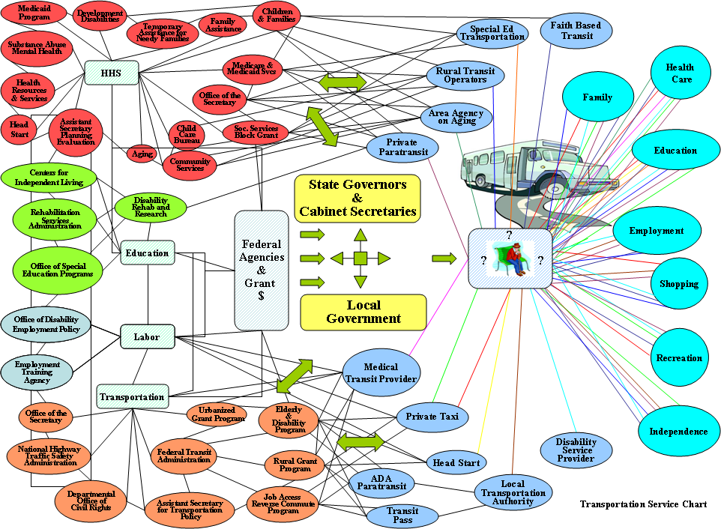
GAO Report – Transportation Service Chart
Notes:
This is the federal maze of programs and funding streams. Point out the lonely person sitting to the right, who just needs a trip.

Slide 27
GAO Report
Obstacles
Reluctance to share vehicles and fund coordination activities due to concerns about adverse effects on clients
Different eligibility, safety standards, and other programmatic requirements that can limit programs’ ability to share transportation resources
Lack of leadership and commitment to coordinate
Notes:
Many programs don’t want to coordinate because their client/customer is “special.” There are also eligibility requirements of programs that must be coordinated. Often times it can be as simple as lack of leadership.
The GAO report grouped obstacles into 3 categories:
Reluctance to share vehicles and fund coordination activities due to concerns about possible adverse effects on clients.
Different eligibility requirements, safety standards, and other programmatic requirements (e.g., driver training) that can limit programs’ ability to share transportation resources
Lack of leadership and commitment to coordinate, as evidenced by the limited guidance and information provided by federal and state agencies on the possible techniques for coordinating services.
Instructor should also discuss Real vs. Perceived – A lot of the obstacles are perceived obstacles. For example, “Bill told me 15 years ago that we can’t share vehicles.” If someone says this, then ask them for the written documentation – generally, it’s not real – it’s perceived.
Source: Transportation Disadvantaged Populations, GAO-03-697

Slide 28
GAO Report
Obstacle mitigation
Harmonize standards (e.g., safety, driver training) to serve additional populations
Expand interagency forums to facilitate communication
Provide financial incentives for coordinating programs
Notes:
Some possible ways to mitigate the barriers are:
Harmonize standards among federal programs (e.g., safety standards related to types of seat belts, driver training requirements), so programs can serve additional populations or better share transportation resources.
Expand interagency forums that would facilitate communication among agencies involved in coordination efforts and to share additional technical guidance and information on coordination among federal and state agencies through a central clearinghouse or improved Web site.
Provide financial incentives or mandates that would give priority in federal funding to those grant applicants that show a strong commitment to coordinate or require specific coordination efforts among grant recipients as a condition of receiving federal funding.
Source: Transportation Disadvantaged Populations, GAO-03-697

Slide 29
FTA Policy
Goal – meet needs of most vulnerable citizens (e.g., elderly, people with disabilities, low-to-moderate income (LMI))
Myriad of programs and strategies developed
Include unique eligibility, reporting, scheduling, service delivery, and funding
TCRP Report 91 estimated an annual savings of $700 million with coordination
Notes:
FTA has a myriad of programs and strategies that are designed to meet the needs of the most vulnerable. This includes the unemployed through the JARC program, and the elderly and disabled through 5310 funding.
Eligibility – Medicaid, ADA, veterans, aging programs, etc.
Reporting – Medicaid units vs. trips
Scheduling – Medicaid up to 3 days in advance or same day
Service Delivery – Different methods and none are right or wrong, just different
Funding – Medicaid is an entitlement, so you cannot deny trips – ADA is “general public”
Through the coordination of programs, TCRP Report 91 estimated there could be a combined impact of about $700 million annually to human service and transit agencies, depending on the type of strategy and number of strategies an agency implements. There are 5 main strategies identified in TCRP 91 (see chart below). The aggregate total of these 5 strategies can be as high as $700 million.
There has been some progress in states such as Florida, Maryland, North Carolina, Washington, and Ohio, but more is needed. In addition, some local transit agencies, (e.g., COTA (Columbus, Ohio); Miami, FL; Denver, CO) have made some progress in coordinating transportation.

Slide 30
FTA Policy
Federal strategy
Department of Transportation/Health and Human Services (DOT/HHS) Coordinating Council was charged with coordinating human service transportation programs with DOT
Notes:
Prior to the Federal Government issuing an executive order that creates an Interagency Transportation Coordinating Council on Access and Mobility (CCAM), which we will discuss in a few slides, there was a DOT/HSS coordinating council. This council was charged with coordinating human service transportation programs with DOT.

Slide 31
FTA Policy
Coordination initiatives
Increased funds for planning
FTA and Center for Medicare and Medicaid Services (CMS) joint working group
National Consortium
Use Intelligent Transportation Systems (ITS) where appropriate
Notes:
Some of the FTA policy initiatives include:
Extra funding for coordination efforts
FTA and Center for Medicare and Medicaid Services (CMS) joint working group
The National Consortium includes CTAA, APTA, Project Action, and Taxicab, Limousine, and Paratransit Association
A strong push to use ITS where appropriate

Slide 32
FTA Policy
Results
Job Access Reverse Commute (JARC) program – matching funds
Medicaid pass program in 23 states
Brokerage programs
Notes:
Some of the success results include:
JARC (Job Access Reverse Commute) program
The Medicaid pass programs allows Medicaid recipients to receive bus passes, instead of expensive door-to-door service.
Finally, many states and Medicaid agencies are using brokerage programs to reduce costs and improve gate keeping. Brokerage programs have many different looks and can range from simple gate keeping to full operations.

Slide 33
Executive Order 13330
Signed by President George W. Bush on Feb. 24, 2004
Established Interagency Transportation Coordinating Council on Access and Mobility (CCAM)
Membership includes:
Transportation
Health and Human Services
Education
Labor
Veterans Affairs
Agriculture
Housing and Urban Development
Interior
Justice
Social Security Administration
National Council on Disability
Notes:
This executive order, issued February 24, 2004, expanded the interagency council to include many more departments and agencies. CCAM was charged with encouraging the coordination of public transportation.
**Note: EO 13330 was not signed “in to law” – it was just signed.

Slide 34
Executive Order – Intent
Promote interagency cooperation
Facilitate access to the most appropriate and cost effective transportation
Encourage customer access
Formulate and implement internal procedures
Develop and implement monitoring procedures
Report due in 1 year
Identify appropriate and effective laws for coordinating transportation services (and duplication of these laws)
Describe results achieved from available programs
Provide recommendations to simplify administrative requirements
Notes:
The executive order was designed to “require” federal agencies to coordinate programs. It also required a review of internal procedures and regulations and required a report due in February 2005 – 1 year from the executive order being signed. The report was actually delivered in March 2005 (see the following slide).

Slide 35
Executive Order – Recommendations
Adopted
Require coordinated transportation planning
Develop vehicle sharing policy
Develop reporting and evaluation requirements
Conduct consolidated access transportation demonstration program
Not adopted
Develop cost allocation guidance
See Appendix for links to United We Ride/CCAM policies
Notes:
CCAM reported back recommendations to president, which eventually became policy. Four policies have been implemented so far. For the complete list, access the United We Ride website at http://www.unitedweride.gov/
Executive Order – Recommendations:
Coordinated Transportation Planning. In order to effectively promote the development and delivery of coordinated transportation services, the CCAM recommends that the Administration seek mechanisms (statutory, regulatory, or administrative) to require participation in a community transportation planning process for human service transportation programs.
Vehicle Sharing. In order to reduce duplicative transportation services, as well as idle time for drivers and vehicles, the CCAM recommends that vehicles used in human service transportation be made available to other Federally-funded programs, consistent with the Common Grant Rule. Within the next year, each Federal Department should review and modify its policies and procedures to proactively promote the sharing of vehicles with recipients and sub-recipients of other Federal programs.
Reporting and Evaluation. The Council recommends the development of a method to permit cross agency analysis of the effectiveness, efficiency, and progress of States, communities, and tribes toward improved coordination of transportation programs, as evidenced by improvements in the overall quality and cost-effectiveness of human service transportation.
Consolidated Access Transportation Demonstration Program. In order to test the feasibility and cost-effectiveness of a new approach to meeting the full range of transportation needs of people with disabilities, older adults and individuals with lower incomes, the CCAM recommends that statutory authority be sought to permit the development of demonstration projects in metropolitan, rural and/or tribal areas. In these demonstration projects a single transportation system--not necessarily a single provider--financed through a consolidated federally funded stream would meet the total mobility needs of transportation-disadvantaged populations.
Cost Sharing. In order to ensure that adequate resources are available for transportation services for people with disabilities, older adults and individuals with lower incomes, and to encourage the shared use of vehicles and existing public transportation services, the CCAM recommends where statutorily permitted that standard cost allocation principles for transportation be developed and endorsed by Federal human service and transportation agencies.
Recommendations 1 – 4 were adopted. Recommendation 5 was not adopted.
Source: United We Ride Progress Report: Implementation of Executive Order 13330, 2007.

Slide 36
Discussion
TCRP Report #97 – Emerging New Paradigms: A Guide to Fundamental Change in Local Public Transportation Organizations
See Appendix for Executive Summary of TCRP 97
Notes:
TCRP Report #97 was designed to explore the future direction of the transit industry. The participants will be asked to read this report prior to coming to the course. Be cautious – some may not have read the report.
Interactivity: The instructor will lead a discussion of the report and it’s implications to the transit industry.
The executive summary of the report is located in the Appendix. The questions to be asked are Why, What, and How.
A current example is when Fed Ex and UPS ship on each other’s vehicles if the result is cost savings.
Source: Executive Summary of TCRP Report 97

Slide 37
A New Paradigm
Why do we need a new paradigm?
Urban sprawl – exurban, no longer city centered
Lifestyle trends – 2 income earners, seniors more mobile and living longer
Transit industry’s institutional environment – risk averse
To change attitudes, we need a new paradigm
Organizational culture
Subordination of customer needs
Lagging progress in ITS
Notes:
There are threats to our quality of life from sprawling development.
Work and life-style trends diminish the usefulness of traditional public transit.
An institutional environment limits creativity.
Organizational cultures that are resistant to change and are reinforced by outmoded policies and programs.
Operations over-shadow the customer.
The transit industry is lagging in the ITS field where it must lead.

Slide 38
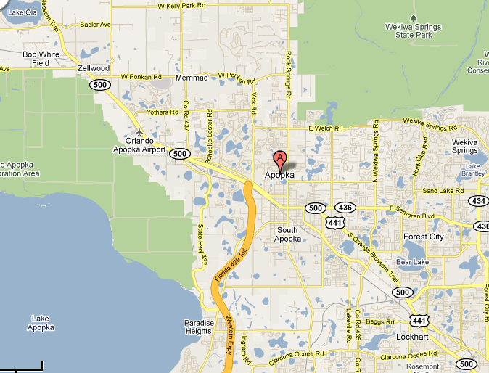
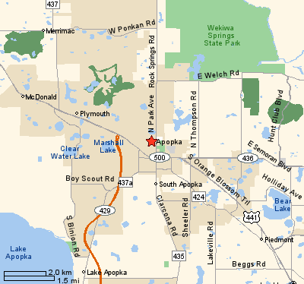
A New Paradigm
Notes:
This map is an example of why we need a new paradigm (rural environment – Apopka, Florida). It is reflective of where people are living now – people need mobility.

Slide 39
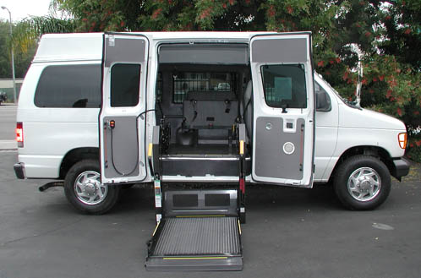
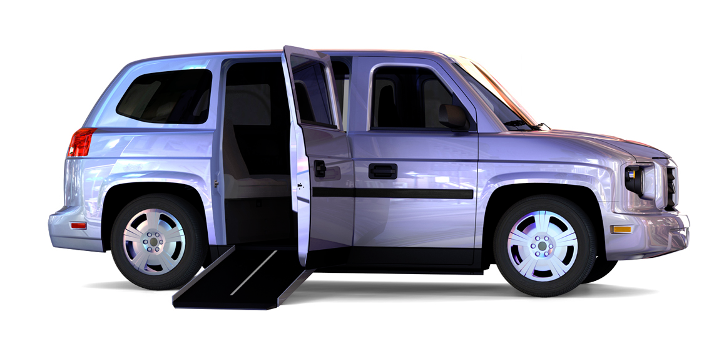
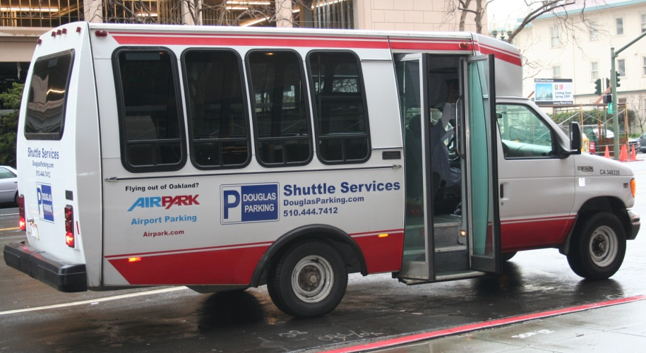
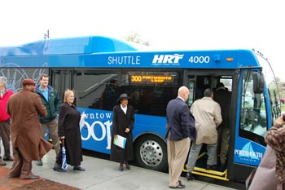
A New Paradigm
Notes:
To provide transit service in rural areas, you need a new paradigm shift to consider new service style and structure.
The ADA created a whole new service structure that many traditional transit systems have not embraced. Just look at some transit websites and try to find a “non-traditional” vehicle. A non-scientific perusal shows less than 10% have recognized the ADA type services.

Slide 40
A New Paradigm
Basic principles
Re-establish quality of the customer’s experience
Separate strategic responsibilities from the production of goods and services
Provide systems of performance measurement
Expand partnerships and alliances
Utilize state of the art information technologies
Notes:
Basic principles:
Re-establishment of the quality of the customer’s experience as a central, strategic focus for the organization
Separation of strategic responsibilities focused on the quality of the customer’s experience from responsibility and accountability for the actual production of goods and services
Systems of performance measurement that bring into balance the quality of the customer’s experience (the emerging strategic goal) and the efficiency with which resources are used (the production goal)
Reliance on expanded partnerships and alliances with both public and private organizations and service providers (for profit and not-for-profit) to ensure responsiveness to shifting customer needs and cost effectiveness in meeting them
Introduction of state-of-the-art information technologies that can link the organization to both its partners and its individual customers in real time
Source: TCRP Report 97

Slide 41
A New Paradigm
Six dimensions of fundamental change
Mission shift
Focus on the customer
Collaboration
Integration
Information technology
Organizational structure change
Notes:
These are the 6 dimensions of fundamental change leading to a new paradigm.
Core mission shift from simply providing a form of capacity with assets you own to a broader responsibility for managing mobility and a wider range of assets.
Measures of success and performance are increasingly focused on the quality of the customer experience.
Collaboration across modes, organizations, and jurisdictions has become a fundamental strategy.
Integration of assets, services, and business functions is a common feature of emerging business models.
Effective links to customers and partners are dependent of state-of-the-art information technologies (e.g., universal fare systems, real-time arrival information, on-street customer information, unified scheduling and dispatch).
New business units, functions, skills, and business processes are inevitable.
Source: TCRP Report 97

Slide 42
Summary
Change your organizational structure to enable transit managers to become mobility managers not asset managers
The paradigm shift is a recognized need not only for FTA, but for all layers of society and business

Slide 43
Learning Activity 1
The “Welch Way” – creative thinking
What is the message in your chapter?
Does it apply to your organization?
What has to change to make it apply to your organization?
Notes:
The intent of using the Jack Welch book is to show participants how a very successful CEO managed to change an organization. The 24 chapters are short and provide a guide for creative thinking.
The Instructor will select and assign one chapter to each participant. They will have 10 minutes to read the chapter. They will assemble in groups and discuss why works and what are the obstacles with other team members. This will take 15 minutes. Then each participant will report back on their principle. This should take about 20-25 minutes. This learning activity should take 45 minutes total.

Slide 44
Module 3
Coordinated Public Transit and Human Service Transportation Plan
The “Coordinated Plan”

Slide 45
Learning Objectives
List the types of funding available to agencies once the Coordinated Plan is complete
Explain the purpose of the Coordinated Plan
Discuss strategies for creating the Coordinated Plan

Slide 46
SAFETEA-LU
Mobility management expenses eligible under SAFETEA-LU
“Mobility management” added to the list of capital projects at 5302(a)(1)(L)
Better funding ratio (80:20 instead of 50:50)
20% match for federal funds can be federal money as long as it’s not DOT
Necessary to have a designated recipient in order to received funds
Notes:
**Note: There could be policy changes with the upcoming reauthorization of SAFETEA-LU, but for now, this is the case under a continuing resolution.
The instructor should discuss designated recipient, dual recipient, etc. The issue of the designated recipient (DR) is one of the more significant issues that arose as a result of SAFETEA-LU. The requirement that the DR has to hold a competitive process made many “traditional” DRs not want to be a DR, because they want to propose on the projects for their own funding.
This has resulted in multiple DRs in urban areas, since the traditional DR is the transit authority. It is an issue and has caused much consternation.
Some MPOs became DRs, which (as a result) changed the method in which funds are distributed.
Some transit authorities are still the DR, but have the MPO conduct the competitive process.
Some transit authorities conduct the process, but let the MPOs make the decision.

Slide 47
SAFETEA-LU
Mobility management programs are funded through:
Demographic specific
5310 – Special Needs of Elderly Individuals and Individuals with Disabilities
5316 – Job Access and Reverse Commute (JARC)
5317 – New Freedom
General public
5307 – Urbanized Area Formula
5311 – Non-Urbanized Formula
Notes:
For general public funds, it is mostly 50:50 money, but sometimes you can get mobility management money (80:20) from 5307 or 5311.
5307 – Urbanized Area Formula (50,000 – 200,000)
5311 – Non-Urbanized Area Formula (< 50,000)

Slide 48
Section 5310
Targets older adults and people with disabilities
Formula program based on state population
Activities funded are derived from local coordinated planning process
Program primarily supports capital purchases, although you can buy service if state allows
Must be contracted services – NOT your operating service
Notes:
The program that has the least number of changes in SAFETEA-LU is the program for the special needs of elderly individuals and people with disabilities – commonly referred to as 5310.
Up to 10% can be used for administration without any match, which includes technical assistance and planning activities.
This program primarily supports capital purchases (e.g., vehicles) for non-profit organizations offering transportation for people with disabilities and older adults. The purchase of services under this program is an eligible capital expense.
The 5310 funding program also conducted is a pilot demonstration with 7 states to use up to 33% of funding to support operational costs. SAFETEA-LU named Louisiana, North Carolina, South Carolina, Alaska, Minnesota, Oregon, and Wisconsin as recommended to participate. 5310 sub-recipients had to demonstrate that activities funded under the program were derived from a local coordinated planning process.
**Note: You can use 5310 funds for both capital and service. You are not restricted to choose one vs. the other.

Slide 49
Section 5310 – Examples
Capital program
Funding (primarily) to support vehicle acquisition for non-profit organizations
80:20 federal/state match for capital
Contracted services
Pilot for “operations” in 7 states
33% can be used for operating expenses
50:50 match for operating

Slide 50
Section 5316
JARC – employment related activities, LMI
Formula based on population
< 200,000 state administered
> 200,000 direct apportionment
Notes:
Job Access Reverse Commute (JARC) program – targeted to enhance access to employment and employment related activities for people with lower incomes. The program also supports REVERSE commute, for example, from the city out to the suburbs or other outlying areas. Historically-this program has been a national discretionary program. SAFETEA-LU changed the program from national discretionary to a formula program. Funding from FY05 – FY09 = $727M.
In the JARC program, apportionments will be made directly to urbanized areas over 200,000 in population based census data on 150% of the population below poverty. The apportionment for communities below 200,000 will go to the state for administration. 10% of the funds, which can include technical assistance and planning, can be used without a match requirement administration.
JARC program funds can be used for both operating and capital support. They can also be used to support capital/planning activities at an 80:20 match. Operating match is 50:50. 10% is for administration.

Slide 51
Section 5316 – Provides funding for…
ITS as a capital expense
Acquiring GIS tools
Implementing ITS, including customer trip information technology
Integrating automated regional public transit, including information, scheduling, and dispatch functions
Deploying vehicle position-monitoring systems
Supporting administration for voucher programs
Mileage reimbursement as part of a volunteer driver program
Taxi trip
Trips provided by human service agencies
Promotion of transit passes
Notes:
ITS is eligible as a capital expense.
Acquiring geographic information system (GIS) tools
Implementing intelligent transportation systems (ITS), including customer trip information technology
Integrating automated regional public transit and human service transportation information, scheduling and dispatch functions
Deploying vehicle position-monitoring systems
Supporting the administration and expenses related to voucher programs.
Mileage reimbursement as part of a volunteer driver program
A taxi trip
Trips provided by a human service agency
**Note: Under the JARC program, vouchers are ONLY for subsidizing ENHANCED SERVICES, so not to support individuals on existing transit services (e.g., bus passes are NOT eligible).
JARC funds can be used to promote transit passes. There are approximately 37 programs that are potential resources for reimbursing the fare. Grantees should also be encouraged to explore options with local business. Promotion, through marketing efforts, of the:
Use of transit by workers with non-traditional work schedules
Use of transit voucher programs
Development of employer-provided transportation

Slide 52
Section 5316 – Examples
Late-night and weekend service
Guaranteed ride home service
Shuttle service
Expanding fixed-route public transit
Continuation projects
Demand-response van service
Ridesharing and carpooling
Transit-related aspects of bicycling
Local car loan programs
Notes:
Eligible purchases:
Late-night and weekend service
Guaranteed ride home service
Shuttle service
Expanding fixed-route public transit routes
Continuation Projects
Demand-responsive van service
Ridesharing and carpooling activities
Transit related aspects of bicycling
Local car loan programs that assist individuals in purchasing and maintaining vehicles for shared rides
Transit related aspects of bicycling means racks on buses, etc., but NOT the actual bike. Local car loan programs must be for RIDE SHARING, not for CAR SHARING (e.g., zip cars). SAFETEA-LU has widened the definition for JARC activities from “new and expanded” to “maintenance of transportation services.” JARC funds can be used to support previously funded JARC projects that meet the intent of the program, however, they also must be part of a local coordination plan and be selected through a competitive process.

Slide 53
Section 5317
New Freedom Program
“New” public transportation service and “new” alternatives to public transportation
Formula based on population
< 200,000 state administered
> 200,000 direct apportionment
Notes:
The New Freedom Program is a new program. This program provides funding to support “new” public transportation services and “new” alternatives to public transportation – beyond the ADA.
**Note: The discussion regarding the components of new public transportation services and alternatives beyond the ADA will be addressed separately.
New formula program
Enhances transportation for people with disabilities
New public transportation beyond the ADA
New alternatives to public transportation beyond the ADA
Funding from FY06 – FY09 = $339M
Formula based on population of PWD – identified by US census
State administered for <200,000
Direct apportionment to UZA >200,000
Operating match is 50:50
Capital match is 80:20
10% for administration
The apportionment for New Freedom is based on the census data regarding the numbers of people with disabilities over the age of 5 in an area. Similar to the JARC program, large urbanized areas (over 200,000) will receive a direct apportionment. The state will manage the program for other size communities. New Freedom can be used for both operating (50:50) and capital expenses (80:20). Up to 10% of the funds can be used for administration, planning, and technical assistance. These administrative funds can be funded at 100% using New Freedom funds.
Funds are available to service not operational on August 10, 2005 OR any service that did not have an identified funding source as of August 10, 2005…as evidenced by inclusion in the Transportation Improvement Plan (TIP) or the State Transportation Improvement Plan (STIP). In other words, if not for the New Freedom program, these projects would not have consideration for funding and proposed service enhancements would not be available for individuals with disabilities.

Slide 54
Section 5317 – Provides funding for…
Access to transit services where complementary paratransit is not required
New “feeder” service
Acquisition of vehicles and equipment
Lifts with larger capacity and modifications to lifts with 600 lb design load
Heavier-duty vehicles for paratransit/demand-response
Additional securement locations on buses
Labor costs of aides to help drivers assist passengers with over-sized wheelchairs
Notes:
“NEW” and “BEYOND” the ADA – New “feeder” service = transit service that provides access to: commuter rail, commuter bus, intercity rail, intercity bus stations, and access to transit services where complementary paratransit is not required under the ADA. So, what’s new? New might be new routes or services can include OTHER populations, but MUST be intended to meet the needs of people with disabilities. Remember, ALL NEW SERVICE must comply with the ADA.
Acquisition of vehicles and equipment
Acquisition of lifts with a larger capacity, as well as modifications to lifts with a 600 lb design load
Acquisition of heavier-duty vehicles for paratransit and/or demand-response service
Labor costs of aides to help drivers assist passengers with over-sized wheelchairs
Installation of additional securement locations in public buses beyond what is required by the ADA
Some other considerations might be around securement or capacity for weight requirements. For example, ADA indicates that vehicles must be equipped with lifts that have the capacity to transfer 600 lbs of weight. However, with the growing number of individuals with power-chairs, the weight of the chair alone is often very heavy, so systems may want to explore the possibility of equipment that exceeds the requirements of the ADA.
Other proposed eligible activities include: purchase and operation of accessible taxi service, administration of vouchers and volunteer programs, and implementation of travel training and/or mobility management activities.
**Note: Mobility Management is considered a capital expense, and since travel training is an element of mobility management, it too is considered a capital expense.

Slide 55
Section 5317 – Provides funding for…
Paratransit service
Expanded hours
Expanded routes
Beyond ¾ mile
Same day service
New door-to-door policy
Door THROUGH door
Enhancements for environmental modifications
Includes signage, curb cuts, technologies to enhance customer access
Notes:
Paratransit services
We are proposing that it might be expanded hours, expanded routes. It can be to provide NEW services for paratransit BEYOND ¾ miles (But this must be NEW activity). It can be DOOR TO DOOR, but must be applied system wide. DOT has issued guidance regarding origin to destination under ADA. However, this is based on reasonable accommodation for “individuals.” If this is an activity supported under New Freedom, it MUST be applied SYSTEM WIDE. This is a change over what was in the proposed guidance. We are also proposing same day services; door through door; and flex route for commuter bus or rail to be considered as an eligible expense. Again, ALL activities supported under New Freedom MUST be part of the local public/human service transportation plan; and must be selected through a fair and equitable competition.
Environmental modifications
New and beyond what is required in ADA
Enhancements including signage, curb cuts, technologies to enhance customer access
NOTE: Not included in a plan prior to August 10, 2005 (SAFETEA-LU)

Slide 56
Section 5317 – Provides funding for…
Accessible taxi
Administration of vouchers and volunteer programs
Travel training
Mobility management
Notes:
Other proposed eligible activities include:
Purchase and operation of accessible taxi service
Administration of vouchers and volunteer programs
Implementation of travel training and/or mobility management activities
**Note: Mobility management is considered a Capital Expense, and since travel training is an element of mobility management, it too is considered a capital expense.

Slide 57
Learning Activity 2
Framework for Action
Self-assessments
Communities
States
See Appendix for Framework for Action Workbook
Notes:
This is a 60 minute presentation concerning the United We Ride Program:
Objective: Discuss the Federal United We Ride Program
Format: Lecture/Activity
Media: Power Point/Flip Chart
Reference material: Framework for Action Workbook one for states and one for communities
There is a shift from providing rides to managing mobility. United We Ride coordinates human service transportation with public and private providers. The program’s premise is that leadership causes action. Therefore, the FTA has taken the leadership role in the Federal Government to make it happen. Self-assessments are the basis for the program. The assessment tool can help states and community transportation agencies work toward achieving their mobility goals.
**Note: The instructor should explain the United We Ride program to participants, the purpose of the learning activity, and then break participants into small groups. There is a self-assessment tool for both states and communities. The instructor will walk through the assessment process and explain the differences between states and community assessments.
Step 1 Individual Assessment – Each person conducts an assessment
Step 2 Convene and discuss – The groups get together and discuss each assessment
Step 3 Take Action – Focus on areas where improvement is needed
The Framework for Action is a document (for states and communities) that includes assessment sections, assessment statements, and discussion points.
Discuss the usage of the United We Ride document, Framework for Action.
Explain the assessment steps to begin dialogue discussions within a community.

Slide 58
Tool for Communities
Five assessment sections
Work together
Take stock of community needs
Consider customers first
Adapt funding
Move people efficiently
Notes:
There are 25 individual assessment statements. The instructor will discuss the questions, the five sections, and discuss the meanings and possible progress ratings. The five sections are listed above.

Slide 59
Community Example
Assessment action steps
Priorities (What) | Lead Responsibility (Who) | Reasonable (When) | Timeline
Putting customer first: Improved coordination Increased service expansion | This group, providers, citizens, and agencies MDOT, MPTA, Group |  | 1 – 3 months to begin Ongoing
Adapting funding for greater mobility: Program flexibility using new funds, match Legislative efforts to increase funding and services Select pilot areas for testing smart cards | MDOT, new group MPTA, new group MDOT, new group |  | ASAP August 2006 ?
Moving people efficiently: Assess unmet needs Smart cards – pilot for standardization of costs, accounting, etc. Better understanding of resources and coordination | MDOT, new group MDOT, new group MDOT, new group MDOT, new group |  | One year 1 – 6 months 1 – 6 months 1 – 6 months

Slide 60
Tool for States
Six assessment sections
Leadership and partnerships
State needs
Consider customers first
Adapt funding
Technology
Move people efficiently
Notes:
The instructor will lead the participants through the manual that is included at the back of this module.

Slide 61
State Example
Assessment action steps
Priorities (What) | Lead Responsibility (Who) | Reasonable (When) | Timeline
State leadership makes transportation coordination a priority issue. | State legislation exists that provides the framework for coordination (RTCAP). | Governor’s office to formally recognize the effort. At the end of the current outreach effort this will include a vision statement, endorsement of the coordinating partners, with a compilation of agency action plans. | End of SFY 2006 – 2007
Governing framework brings together providers, agencies, and consumers. | Most Integrated Setting Coordinating Council (MISCC), Developmentally Disabled Planning Council (DDPC), and other state committees are recognizing delivery of transportation services as a key issue. | Bring MISCC, DDPC, and planning groups into the UWR. State Partners effort to maximize input from the disabled community. | Early 2006

Slide 62
Learning Activity 2
Framework for Action
Assign 4 – 5 state and community teams
Walk through the self assessment with your team
Conduct an assessment (10 – 15 minutes)
Discuss the rating with your team (15 – 20 minutes)
Create assessment action steps – located at back of module
Appoint a spokesperson and report back
Notes:
The instructor will make up 4-5 member teams and have theses individuals walk through the self assessment. The teams should have State individuals on one and Community individuals on another. The teams will be given 10-15 minutes to conduct their own assessment of their agency. They will then be given 15-20 minutes to get back as a group and discuss their ratings with other team members. Then each group will create assessment action steps; the document for doing this is located at the back of the module. The teams will appoint a spokesperson and report back. The reports will take 15-20 minutes.

Slide 63
Why do you need a “Coordinated Plan”?
SAFETEA-LU – the authorizing legislation required by law
Requirement to receive §§ 5310, 5316, and 5317 funds
More efficient and effective; good business sense

Slide 64
Coordinated Plan – Actual Document
Coordinated Public Transit Human Services Transportation Plan
The process of building a Coordinated Plan involves several important steps
Coordinated Plans can be created for cities, counties, regions, or jurisdictions

Slide 65
Coordinated Plan – Actual Document
Assessment of available services
Assessment of needs
Gap analysis – Strategies and activities to meet needs
Priorities for implementation will depend on needs of community

Slide 66
Pre-Development of the Coordinated Plan
Purpose of the Plan – develop short-range planning and management activities for coordinating public transit and human service transportation
Plan can include:
Mobility management funded as a capital expense at 80:20
Technology and personnel (e.g., coordination staff, brokers, travel navigators)
Plan excludes actual costs of service operation

Slide 67
How to Develop the Coordinated Plan
Transportation Coordination Toolkit
Provides planning guidelines for coordinating state and local specialized transportation services
fta.dot.gov/planning/metro/planning_environment_4016.html
Self-assessments (Framework for Action)
Additional outreach includes community planning sessions, focus groups, surveys, and public meetings
dot.wisconsin.gov/localgov/coordination/additional.htm
Notes:
Source: http://www.fta.dot.gov/planning/metro/planning_environment_4016.html

Slide 68
Where is the Coordinated Plan Developed?
Locally
Regional Planning Commission (RPC)
Metropolitan Planning Organization (MPO)
Counties
Cities
Regions
Notes:
Before you develop the Coordinated Plan, make sure you have all the pieces involved. The Plan is developed based on your defined community.

Slide 69
Checklist for Coordinating Transportation
Identify stakeholders (BORPSAT)
Organize initial meeting
Establish commitments and form partnerships
Specify goals, objectives, and constraints
Jointly identify client needs
Identify transportation resources
Design service and finance options
Notes:
The coordination planning checklist below provides a representative synthesis of a coordinated guidance from states and localities around the country. At each of these steps, it is vital to include as broad a range of participants as possible. All of these planning steps are crucial to success in the operational phases of transportation service. The planning process needs to be seen as continuous and iterative: plans are made, tested, refined, and retested in a repetitive cycle until they meet the systems goals and objectives in an efficient manner before operations begin. Nevertheless, operating procedures may need to be evaluated and modified several times before goals and objectives can be met most effectively.
Identify Stakeholders (BORPSAT – Bunch of right people sitting around the table): Consumers, Customers, Disadvantaged constituencies, Public transit providers, State and local Human Service Providers, Tribal Representatives, Community based organizations, Business Community, Economic development agencies, Elected officials
Organize Initial Meeting: Open up lines of communication. Probably one of the most critical steps. BORPSAT (a bunch of the right people sitting around a table). Have an agenda, a purpose and a desired outcome. Make it brief, but focused.
Establish Commitments and Form Partnerships: Transportation Brokerage Agencies, Public and private transportation providers, Private-non-profit operators, Medicaid organizations, Tribal agencies, Head Start, Schools, Area Agencies on Aging, Business, Civic, Non-profit, Elected officials
Specify Goals, Objectives, and Constraints: Use the committee structure to review goals and objectives.
Set in terms of service levels and types of trips, types of trips and geographic areas
Identify fiscal, political, and administrative, legislative, and sometimes individual constraints.
Jointly Identify Client Needs: Obtain from local advocacy organizations where the need is the greatest.
Identify Transportation Resources: Conduct survey or obtain information from local planning agency or State DOT.
Design Service and Finance Options: Service characteristics, Operational characteristics, Administrative features. This can be achieved through a gap analysis by evaluating unmet needs and matching them to resources available. After your gap analysis, it’s important to monitor your projects to determine cost effectiveness.
Continued on the next slide.
Source: http://www.fta.dot.gov/planning/metro/planning_environment_4016.html

Slide 70
Checklist for Coordinating Transportation
Select a plan of action (connect projects when possible)
Confirm agency and community commitments
Develop implementation and funding plan
Measure performance, monitor, and evaluate
Notes:
Select a Plan of Action: Specify a set of evaluation criteria, Criteria can be weighted based on the local desires. Committee adopts the plan of action. Connect projects when possible.
Confirm Agency and Community Commitments
Develop Implementation and Funding Plan: Detail an Action plan and assign responsibilities and due dates.
Measure Performance, Monitor, and Evaluate: During and after implementation always evaluate what is happening and identify where and what changes are needed.
Source: http://www.fta.dot.gov/planning/metro/planning_environment_4016.html

Slide 71
When to Submit the Coordinated Plan
Before award of funding!
FTA asks for certification that project is in the Coordinated Plan – provide page number
Only need transit agency’s name, not details
All Coordinated Plans should be complete and on file with FTA
Update at least every 4 years

Slide 72
Issues
Level of participation – should be representative of your local area
Selection – competitive process can create issues with designated recipient
Projects must be derived from the Coordinated Plan

Slide 73
Coordinated Planning
Leadership
Collaborative
Development
Public Involvement
Assessment of Needs
and Resources
Identify Implementation Strategies
Coordinated Plan
Notes:
Coordinated planning starts with leadership.

Slide 74
Leadership
Do you have a lead agency?
Is there a local champion?
Has a local coordinator been identified?

Slide 75
Collaborative Development
Are public and private transportation providers involved?
Have consumers/advocates been invited to the planning process?
How are human service agencies and providers engaged in the planning process?

Slide 76
Public Involvement
Has information been widely distributed?
Is information available in alternative formats and languages?
Have meetings been scheduled at times and in places that are accessible?
Is transportation available to meeting locations?

Slide 77
Assessment of Needs and Resources
Does your community have an inventory of vehicles currently used for human service transportation?
What types of human service transportation is currently provided?
Is inventory of funding, staff, and other resources available?
Have current providers identified common information and data points?

Slide 78
Identify Implementation Strategies
Policy and funding strategies
Have programs developed joint policy statements or a Memorandum of Understanding (MOU)?
Is there a system for tracking and sharing data across programs?
Have partners agreed on common measurements and definitions to support the tracking system?

Slide 79
Identify Implementation Strategies
Customer focused strategies
Is information about transportation easy to access?
Do riders have access to travel training and consumer education?
Is there a seamless payment system that supports user-friendly services?
Are customers involved in the design and implementation of services?

Slide 80
Identify Implementation Strategies
Mobility strategies
Is a system in place to coordinate numerous transportation providers?
Does the community offer a “family of services” to meet a broad range of needs?
Are efforts to share information, databases, equipment, maintenance, and other features available?
Are mobility managers or travel navigators available in the community to assist customers with planning trips?

Slide 81
Identify Implementation Strategies
Technology strategies
Is technology used to support access to customer information?
Does technology exist to enhance scheduling, dispatching, reporting, and billing across programs?
Is technology used to provide the ability to share information and data across programs?
Is technology used to support universal payment cards, fare cards, and similar mechanisms?
Notes:
**Note: Use caution when sharing information (e.g., data sharing between agencies) that privacy laws can complicate.

Slide 82
Coordinated Planning
Leadership
Collaborative
Development
Public Involvement
Assessment of Needs
and Resources
Identify Implementation Strategies
Coordinated Plan
Notes:
The final product is the Coordinated Plan.

Slide 83
Coordinated Plans
Examples
http://web1.ctaa.org/webmodules/webarticles/anmviewer.asp?a=8&z=62
Click Tools
Click Coordinated Transportation Plans

Slide 84
Refinement of the Coordinated Plan
Identify issues
Missed partners
Regionalization
Inventory refreshment
More clarity on the Plan’s process
Involvement
Selection
Eligibility
Notes:
It’s important to update your plan! If you already have a Coordinated Plan in place, refine your Coordinated Plan by performing the activities listed above.

Slide 85
Coordination Ambassadors
Work with FTA Headquarters and all 10 regional offices
Work with state and local governments
Extend coordination awareness
Help identify key stakeholders
Serve as a resource
Contacts vary by region
http://web1.ctaa.org/webmodules/webarticles/anmviewer.asp?a=72&z=84

Slide 86
Role of Coordination Ambassador
Technical assistance
Training
Mobility management
Coordinate local issues using global applications
Local strategies
Education, facilitation, and awareness
Support a local planning process

Slide 87
Barriers to Coordination
Turf issues
Perceptions
Don’t rock the boat
Insurance
Cost allocation
Notes:
Many of the barriers you will encounter are from the agency directors themselves. It is turf protection and misinformation. One of the tools you have and must use is effective communication. An effective and consistent education and information dispersal system is necessary.

Slide 88
Summary
Transit system is there for the long haul and can be the backbone of the Coordinated Plan
The General Manager and Board set the tone for improving public transit
Leadership, participation, and continuity are key to creating a well-defined Coordinated Plan
Remember to review your Coordinated Plan and continue to communicate with stakeholders!

Slide 89
Module 4
Tools, Strategies, and Technology

Slide 90
Learning Objectives
Discuss the tools and strategies available to mobility managers, including innovative mobility options
Describe the importance and future of livable communities
Explain how technology can support mobility management activities

Slide 91
Tools and Strategies
Public transportation
Car-sharing
Ridesharing/carpooling
Guaranteed ride home
Slugging/instant car pool
Ride bank
Voucher programs
Volunteer programs
Transportation Management Associations (TMAs)
Travel navigators
Demand management techniques
Livable communities
Budget development/ cost allocation
Notes:
This slide lists the mobility options. Each option will be discussed in detail on the following pages.

Slide 92
1. Public Transportation
Improve by:
Increasing availability
Enhancing quality
Improving cost-effectiveness
Eliminating duplication
Design:
Fixed routes
Service routes
Demand responsive – same day
Route/point deviation
Shuttles
Circulators

Slide 93
2. Car-Sharing
Allow consumers to rent cars by the hour
Offer a variety of vehicles
Notes:
“Car-sharing actually originated out of a county government idea,” explained John Williams, Director of Marketing for Flexcar, the oldest of the car-sharing programs. “Back in 1999, King County Metro Transit was looking for a program that could complement its public transit system. They had been watching the car-sharing experiment in Europe and decided that was just what they needed.”
Zipcar is a car-sharing programs that allow the consumer to rent cars by the hour. Hourly rates include parking, gas, insurance and maintenance of the vehicle. Zipcar offers a variety of cars including hybrids, trucks and even mini-vans – to rent by the hour. Although cars can be rented for any length of time, the rate structures are ideally suited for those quick trips around town and not necessarily designed for the weekend visit to the country. There are also local “hourly rental car” companies.
PhillyCarShare is a non-profit organization that provides members with access to a fleet of vehicles on an hourly basis. Once you join the community you get a personal key to hundreds of cars parked steps from your office and home. Affordable rates cover gas, major insurance, and even your ride on SEPTA rail. Drive Prius hybrids, Audis, pickups, wagons, minivans and more. Just reserve online, hop in using your personal key, and go.
Source: http://www.phillycarshare.org
http://www.zipcar.com

Slide 94
3. Ridesharing/Carpooling
Local ridesharing programs
VPSI – national vanpool company
Zimride.com
eRideShare.com
Commuter Connections
Keep in mind, limitations of local vs. national databases
Notes:
Local carpool/vanpool commuter connections in Washington, DC – run by WASHCOG.
VPSI is a national vanpool company.
Carpooling is when two or more commuters ride together in a private automobile on a continuing basis, regardless of their relationship to each other or the cost of sharing agreements. Carpooling is the simplest and most common ridesharing arrangement.
Finding someone to carpool is easy because employees of a single company often live near each other. Neighbors may work at different companies located only a short distance apart and have the same work hours.
Carpools can be arranged in one of the following ways:
One person may drive all the time, while the passengers contribute only to the cost (e.g., gas and parking).
Participants may alternate driving and not exchange money.
The carpool driver may pick up passengers at their homes, or they may meet at a central location.
Carpools can and do include family members.
**Note: NTI will always request internet, but it may not always be available to access these sites.

Slide 95
4. Guaranteed Ride Home
Provides commuters who use an alternative commute mode (e.g., ridesharing, mass transit, bicycling, walking) with a guaranteed ride home when an emergency arises
Available to commuters who work in the Washington metropolitan area and live in the Guaranteed Ride Home service area
Various costs to use
Notes:
For many commuters, choosing “a smarter way to work” (e.g., sharing the ride in a carpool or vanpool, taking transit, biking or walking to work) means saving hundreds of dollars each year. If you’re taking “a smarter way to work” or even considering it, Commuter Connections is making it even smarter with Guaranteed Ride Home (GRH).
GRH provides commuters who regularly carpool, vanpool, bike, walk, or take transit to work with a reliable ride home when one of life’s unexpected emergencies arises. Commuters will be able to use GRH to get home for unexpected personal emergencies and unscheduled overtime up to FOUR times per year. Restrictions apply, so be sure to read the participation guidelines (costs and regulations may vary by state).
GRH is designed to rescue commuters who are worried about how they’ll get home when an emergency arises. Knowing there’s a guaranteed ride home allows you to use commuting options like transit and carpools with confidence. Think of it like insurance.
Questions? Call us at 1-800-745-RIDE.
http://www.commuterpage.com/ridehome.htm

Slide 96
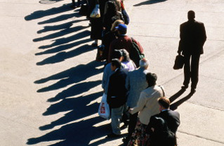
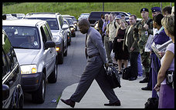
5. Slugging/Instant Carpools
Unique form of commuting in Washington, DC
Created by citizens to solve commuter problems
Faster than bus, metro, or train… and it’s free
Notes:
Slugging and slug lines:
Slugging is a term used to describe a unique form of commuting found in the Washington, DC area. It has thousands of vehicles at its disposal, moves thousands of commuters daily, and the best part, it’s free! Not only is it free, but it gets people to and from work faster than the typical bus, metro, or train. It’s unique because it’s not a government sponsored commuter program, but one created out of ingenuity from local citizens to solve commuter problems.
Usually slug lines appear at park-and-ride lots.
Austin, TX – Another term for slugging is “body snatching.”
San Francisco, CA – Also has slugging.

Slide 97
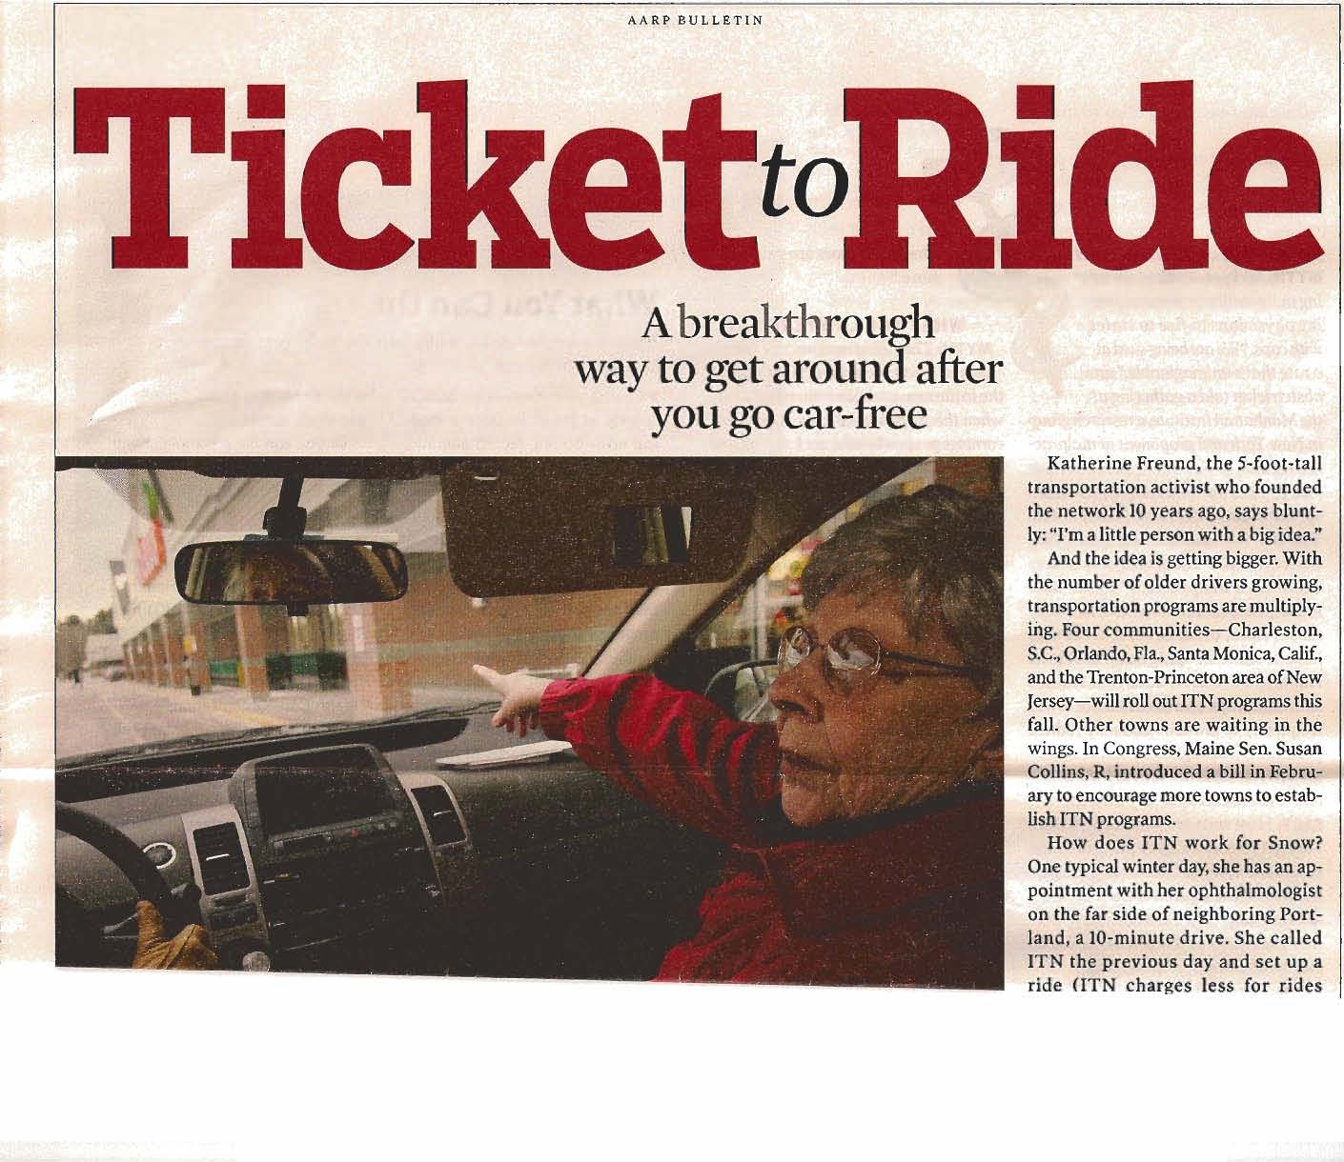
6. Ride Bank
Independent Transportation Network (ITN)
Local network
Notes:
National network – Independent Transportation Network (ITN) franchise fee of $100,000 – 15 installations.
Local network
Ride Bank is a process to get people, who no longer drive, to have mobility. You pay money to a “Ride Bank,” and when you need a ride, it’s paid. Or, you can provide rides prior to giving up your car to earn points in your bank. Then you can have rides in the future. You can also “gift” rides (e.g., children put money in mom/dad’s ride bank). There is also a “personals” option, which allows you to have the same driver every time.
Source: “The Feel-Good Alternative to Driving” http://www.aarp.org/content/aarp/en/home/family/articles/life_after_driving.comments.0.html

Slide 98
7. Voucher Programs
Usually government sells you a voucher at reduced price
Checkbook model
i-voucher model
sites.google.com/site/voucherprogram/
Voucher networks – human service transportation providers, local taxi companies, neighbors, etc.
Notes:
Voucher programs were established in the early 1970’s. Vouchers are tickets or coupons that eligible riders give to participating transportation providers in exchange for a ride.
Checkbook model – Customers receive a pre-printed checkbook with an allocation of miles or trips from a support agency (e.g., Independent Living Center). The customer trades the check for a ride with a volunteer or transit agency driver. The support agency helps locate rides, offers planning support, allocates vouchers and reimburses drivers. Although volunteer drivers are paid, the driver maintains volunteer status under IRS rules.
i-voucher model – A human service agency or other entity sets up, authorizes, and tracks ride programs using special software. Voucher sites print and mail i-vouchers to eligible riders or send bus ledgers to transit providers. i-vouchers contain information about destinations, mileage, value, and documentation (e.g., driver’s signature, rider data). Voucher sites reimburse drivers and service providers and invoice funding sources.
Voucher programs are typically funded by one or more state or local agencies. They can also be funded with federal money. Voucher systems give people living in rural areas choice and control in managing their lives. Take full advantage of both formal and informal transportation networks (e.g., public transit, taxis, human service transportation providers, volunteer drivers, family, neighbors).
Example – Association of Programs for Rural Independent Living (APRIL)
Transportation Voucher Project 2001-2006
A total of 16 sites in 10 states across the country
$1.5M over 5 years
Critical to success were CTCs (Community Transportation Coordinators) in implementing and administering the project – CTCs are Mobility Managers.
Example – Houston METRO
Houston provides monthly vouchers to taxi companies. The user calls the taxi company direct. The user pays the ADA fare, and METRO pays up to $9.00 more. The user pays after $11.00. Average cost to METRO is much less (in the $5.00/trip range) than METRO ADA, which is over $20.00/trip. This cannot be counted as an ADA trip, because the user can potentially pay more than twice the METRO base fare.

Slide 99
8. Volunteer Programs
Establish and manage a volunteer driver pool
Train volunteer drivers
Must retain program records for all drivers
Notes:
Establishing and Managing a Volunteer Driver Pool: Maintaining a well trained, enthusiastic driving staff is key to the success of any volunteer transportation program. Whether a driver uses an agency-owned vehicle or their own vehicle (POV), he/she is responsible for the safety of all riders. There are two important features to remember when developing or managing a volunteer driver workforce.
It is important to recognize that all drivers, whether using agency vehicles or their personal vehicles, should be appropriately trained to safely carry out their responsibilities.
All volunteer drivers who operate agency vehicles should follow the same policies and procedures as paid drivers (if any) operating similar vehicles for the sponsoring organization.
Training Volunteer Drivers: Sponsoring organizations have the responsibility of assuring that transportation volunteers and staff have the tools necessary to be successful in their positions. Success depends on proper selection and management of volunteer and paid drivers including quality program orientation, training and evaluation. The quality of service and the sponsoring organization’s access to insurance depend upon the driver's ability to effectively interact with the community and to safely operate specialized vehicles. Drivers who transport community members are legally held to a higher degree of care than any other driver on the road. A sponsoring organization should require specific training for all drivers operating vehicles or providing transportation services as part of a volunteer driver program. Training for all volunteers should be structured to conform to the duties in the job description. Programs should either identify a staff person or persons to be a trainer or can arrange for timely access to other trainers.
Program Records: The sponsoring organization must have a file containing all pertinent information about each driver. The Federal Privacy Act covers volunteer drivers. All personal information about the driver should be covered by a written confidentiality policy that parallels the organization's personnel policies. The following is a list of the documents, and related information, to be maintained in driver files: original volunteer/employment application, interview and reference check documentation, criminal history documentation, Department of Licensing history report and any subsequent history reports generated, copy of current drivers license, copy of training certifications, on-going objective documentation, any documentation relevant to performance, and a copy of current personal automobile insurance card. Personal auto insurance verification must be kept current.

Slide 100
9. Volunteer Programs – Examples
Agency Council on Coordinated Transportation (ACCT)
Council of state agencies, transportation providers, consumer advocates, and legislators, who facilitate the coordination of transportation through collaborative processes
www.wsdot.wa.gov/acct/
York County Community Action Council (Maine)
Volunteer driver program
www.yccac.org
Notes:
A major resource in rural areas are volunteer programs. Below are 2 examples.
State of Washington has developed an elaborate volunteer program – Agency Council on Coordinated Transportation (ACCT).
Reason ACCT Was Created – The legislature found that transportation systems for persons with specials needs were not operated as efficiently as possible. Often people cannot access needed services because of transportation barriers. A structure was needed that could communicate across organizational boundaries and facilitate coordinated special needs transportation systems through collaborative state and community processes. To accomplish this, the Agency Council on Coordinated Transportation was created in the 1998 legislative session.
ACCT Mission – The Agency Council on Coordinated Transportation (ACCT) is a Council of state agencies, transportation providers, consumer advocates, and legislators with the mission to:
Promote the coordination of special needs transportation
Provide a forum for discussing issues and initiating change
Provide oversight and direction to the state’s coordination agenda
Report to the legislature and propose legislative remedies
Source: http://www.wsdot.wa.gov/acct/about_acct.htm#mission
2. York County Community Action Council (Maine) Volunteer Driver Program Highlights
YCCAC serves about 20,000 low income individuals, in 29 communities, about 1000 square miles; volunteers completed 64,164 trips and 2,989,671 miles! (average trip was 46 miles)
85+ volunteer drivers, screened and trained (references, valid license, registration, proof of insurance, CORI, driving record)
2.5 hour orientation,and requirement to attend future trainings; trainings are rated on a point system, and drivers have to accumulate a certain number of points, ongoing, they offer things like First Aid, Communicating w/Children w/Special Needs, Driving Dynamics, Bloodborne Pathogens, Confidentiality and Mandated Reporting, Child Safety Seat
Handbook w/policies and procedures
Monthly newsletter for and about volunteer drivers
Operate their own vehicles, reimbursed for mileage and tolls only; wear photo ids and have official YCCAC placards for their cars (for people who are not on their regular van route)
Source: www.yccac.org
http://web1.ctaa.org/webmodules/webarticles/articlefiles/ct/winter06/connie.pdf

Slide 101
9. Transportation Management Associations
TMA examples
Camden County, NJ
Cross County Connection
www.driveless.com/googlemap.html
Sacramento Transportation Management Association
www.sacramento-tma.org
Notes:
Camden County, NJ has a number of transportation programs under their wings, including but not limited to: New Jersey Transit, Rutgers University Camden Shuttle Bus, Port Authority Transit Corporation of Pennsylvania and New Jersey (PATCO), Sen-Han Transit, and RiverLink Ferry.
Commuter, municipalities, county governments, and employers all benefit from Cross County Connection’s work in seeking and providing viable transportation solutions for the southern New Jersey region. Commuters benefit by using Cross County Connection as a centralized source of valuable information on joining carpools or vanpools, using trains, shuttles or buses, commuting by walking or biking, and finding timely traffic or roadway construction alerts. They even reward commuters for using alternate transportation. Municipalities and County Governments rely on their expertise in the creation and promotions of community shuttles and bicycle and pedestrian facilities, GIS mapping, transportation assessment and evaluation, and grant assistance. Employers find a ready resource to help their employees get to work. From basic services – providing bus or train schedules – to the complex full scale employee commute benefit programs, Cross County Connection seeks practical solutions to the issues employers face.
Sacramento Transportation Management Association has a number of programs they administer. These include: carpooling, commuter links, vanpool seats, bicycling, emergency ride home, park-ride lots, air quality, and traffic conditions. Sacramento TMA is an independent, non-profit membership association, representing 182 employers and helping more than 90,740 commuters find alternatives to driving alone to work. The TMA was founded in 1989 by employers concerned about the negative impact of Sacramento's traffic congestion and air pollution on their employees’ commutes and quality of life.
These programs are not all transit, but also include traffic and bicycles. Other TMA’s are involved with employer subsidized bus passes, carpools, van pools. They can also work on parking priorities and traffic signal phasing.
Source: www.publictransportation.org/systems/state.asp?state=NJ#A9
www.driveless.com/aboutus_mission.htm
www.sacramento-tma.org

Slide 102
10. Travel Navigators
Also called Travel Trainers
Teach groups to use public transit, which leads to improved mobility and reduced costs
Peer-to-peer is best
Can be conducted by transit agency or human service agency
Example – Easter Seals training program
Notes:
Easter Seals Project ACTION's Introduction to Travel Training course is a free training initiative to increase the skills, knowledge, and abilities of travel training professionals.
Source: http://projectaction.easterseals.com/site/PageServer?pagename=ESPA_travel_training_intro_course_brochure

Slide 103
11. Demand Management Techniques
Congestion pricing
HOV/HOT lanes
Telecommuting
Telecommuting centers – location to conduct business not at the office, usually located outside a city

Slide 104
12. Livable Communities – Definition
“A livable community is one that has affordable and appropriate housing, supportive community features and services, adequate mobility options, which together facilitate personal independence and the engagement of residents in civic and social life.”
-Beyond 50.05, AARP
Notes:
Livable communities are part of system management.
Source: Beyond 50.05: A report to the Nations on Livable Communities, AARP

Slide 105
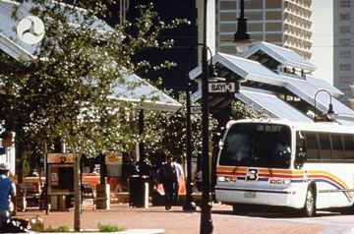
Why are Livable Communities Desirable?
Quality of life
Cost savings compared to institutions
Community engagement
Minimize detachment
Participation in society
Notes:
Socialization includes partners (e.g., movie partner, food partner, hobby partner). Livable communities facilitate this. It is cheaper to age in a community/house than an institution. Transportation options are key to a successful livable community.

Slide 106
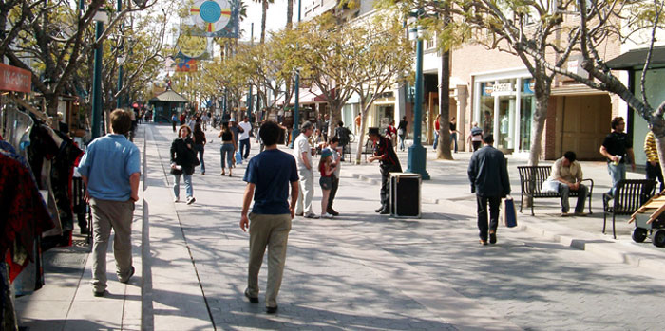
Community Attachment
Walk-ability
Housing options
Patio homes, condominiums, etc.
Park facilities, open space
Social and intellectual events
Community engagement
Notes:
What is a livable community? Community attachment, home design, affordable and accessible housing, transportation and mobility. These 4 topics will be discussed on the next few slides.

Slide 107
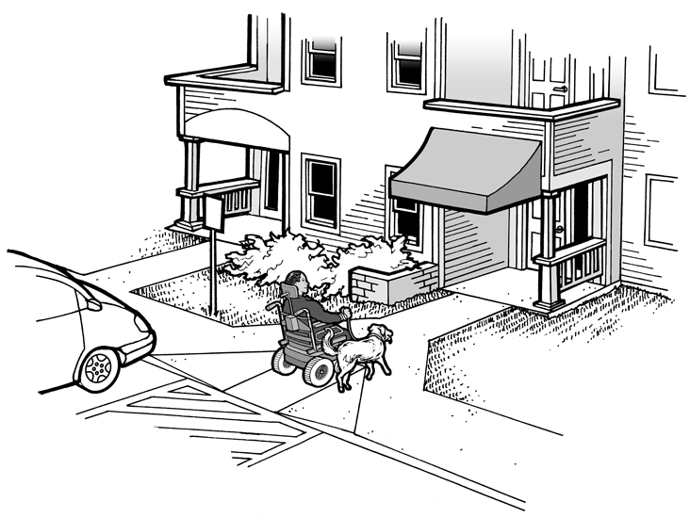
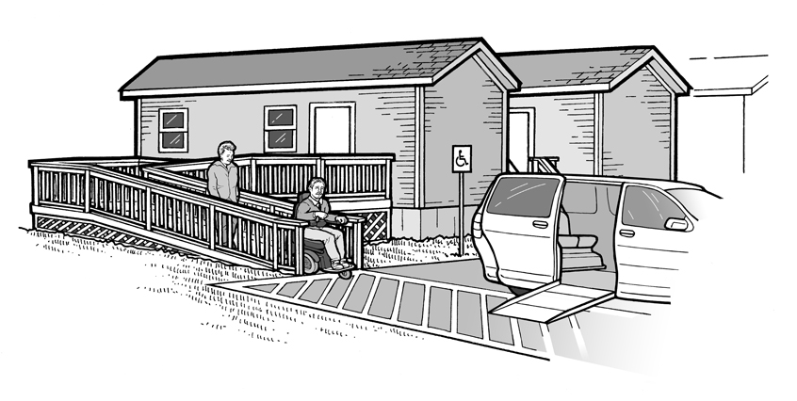
Home Design
Accessibility
Single level/no stairs
Wider doors
Ramps
Lower counters
Door handles
Notes:
No stairs – better for wheelchairs and walkers
No door knobs – better for arthritis
Home design allows people to live in their homes longer. In order to live longer you need mobility.

Slide 108
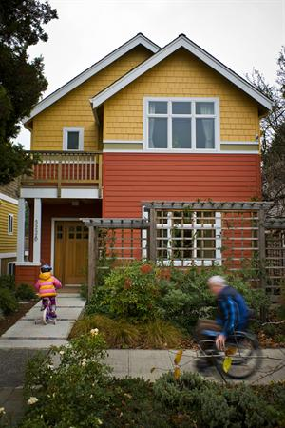
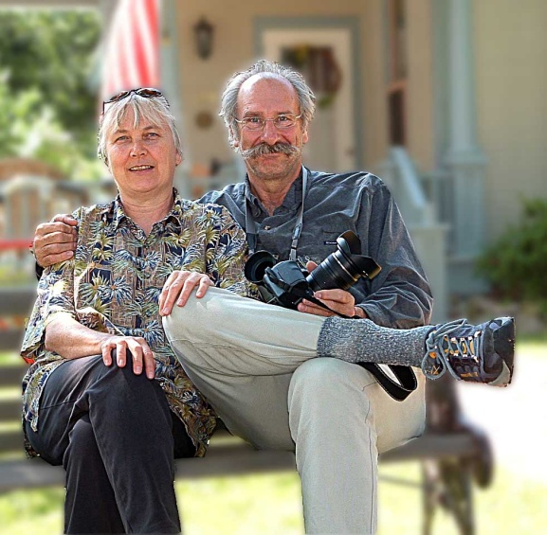
Affordable and Accessible Housing
Housing is the largest expense category for people > 45 years old
Continuing care
Single family, assisted living, nursing home
Aging at home
Modifications
Notes:
The key is to provide mobility options for people to age at home.

Slide 109
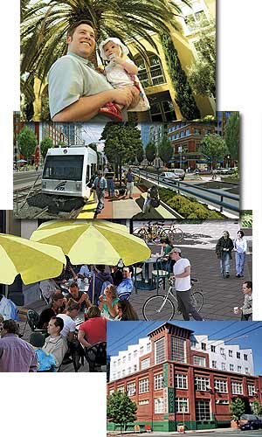
Transportation and Mobility
Near public transportation
Options
Community network
Public network
Volunteers
Driving cessation – loss of mobility
Notes:
⅓ of Americans can’t or choose not to drive. Yet, most communities around the country are laced with roads that are inhospitable, at best, to people traveling by foot. Children, older Americans, and minorities are especially at risk.
Sacramento Example – Paratransit, Inc. provided used vehicles to a Vietnamese community for their internal transportation. As a result, the Vietnamese community began to provide rides for Paratransit, Inc. at a cheaper cost than Paratransit, Inc. This provided income to the Vietnamese community and cheaper costs for Paratransit, Inc.
In the 52 largest metro areas, annual spending of federal funds on bicycle and pedestrian projects averaged just $1.39 per person!
Nationwide, less than 1.5% of funds authorized under the current federal transportation law have been spent on projects to improve the safety of walking and bicycling. It’s a ridiculously low figure when you consider that pedestrians comprise 11.8% of all traffic deaths and trips made on foot account for almost 9% of total trips.
Beverly Foundation is a research foundation on the West Coast. They conducted a study that concluded if you teach people to use alternative forms of transportation before they need them, then the success rate of getting those people to use them is much higher.

Slide 110
Livability Principles
Provide more transportation choices
Promote equitable, affordable housing
Enhance economic competitiveness
Support existing communities
Coordinate and leverage federal policies and investment
Value communities and neighborhoods
Notes:
On June 16, 2009, EPA joined with the U.S. Department of Housing and Urban Development (HUD) and the U. S. Department of Transportation (DOT) to help improve access to affordable housing, more transportation options, and lower transportation costs while protecting the environment in communities nationwide. Through a set of guiding livability principles and a partnership agreement that will guide the agencies' efforts, this partnership will coordinate federal housing, transportation, and other infrastructure investments to protect the environment, promote equitable development, and help to address the challenges of climate change.
Livability principles:
Provide more transportation choices – Develop safe, reliable, and economical transportation choices to decrease household transportation costs, reduce our nation’s dependence on foreign oil, improve air quality, reduce greenhouse gas emissions, and promote public health.
Promote equitable, affordable housing – Expand location and energy-efficient housing choices for people of all ages, incomes, races, and ethnicities to increase mobility and lower the combined cost of housing and transportation.
Enhance economic competitiveness – Improve economic competitiveness through reliable and timely access to employment centers, educational opportunities, services and other basic needs by workers, as well as expanded business access to markets.
Support existing communities – Target federal funding toward existing communities – through strategies like transit oriented, mixed-use development, and land recycling – to increase community revitalization and the efficiency of public works investments and safeguard rural landscapes.
Coordinate and leverage federal policies and investment – Align federal policies and funding to remove barriers to collaboration, leverage funding, and increase the accountability and effectiveness of all levels of government to plan for future growth, including making smart energy choices such as locally generated renewable energy
Value communities and neighborhoods – Enhance the unique characteristics of all communities by investing in healthy, safe, and walkable neighborhoods – rural, urban, or suburban.
Source: http://www.epa.gov/smartgrowth/2009-0616-epahuddot.htm#livabilityprinciples

Slide 111
13. Budget Development/Cost Allocation
Budgeting
Bottoms up approach – model
Prior budgets – repeat mistakes
Rate calculations
Cost allocation
Why?
Hours, miles, fixed
Notes:
Cost allocation is the basis for sharing vehicles and trips. Medicaid like the term cost sharing, but it is all the same in reality.

Slide 112
13. Budget Development
How to develop budgets
Zero based
Past experience
Peers
Notes:
Most government and non-profit agencies operate on the zero based budgeting principle. This assumes you rebuild a budget eve year. It is not uncommon for the agency to be asked to develop multiple budgets with different assumptions.
Past experience is a good place to start. The only problem with using past experience is that if there was an error in the past it will continue in the future. That is why it is best to use past experience only as a guide and not as an absolute. In other words, don’t just increase your budget by 3% across the board, look at each line item.
Another good place to look for budget information is to review peer’s budgets and look at he NTD database for guidance. Again don’t use these as absolutes, you don’ know what is included in various line items

Slide 113
13. Budget Development
What is needed?
Hours, miles, employees, vehicles, other pertinent information
Include everything – then exclude if necessary
Notes:
The bases for every budget is the days of operations, the revenue and total miles and hours. The driver pay hours and estimation of any overtime. You also need to know the number of vehicles, the number of non-driving positions, the fringe benefits costs, rent or depreciation, utilities costs. After mentioning these have the class list some additional.
When developing a budget all costs should be included, whether or not you as an agency has to pay them or not. You can always extricate them later. To get the true cost per unit you need have all the cost included

Slide 114
13. Budget Development
What are billing units?
Per mile
Per trip
Per hour
Fully allocated costs
Marginal costs
Notes:
There are different ways to “charge for service.”
If you are charging another agency for service, you want to use the fully allocated costs. When you negotiate you need to be within the fully allocated and the marginal cost..
Marginal costs include drivers pay and fringe benefits, fuel, maintenance, etc.

Slide 115
13. Cost Allocation
What is it?
Accounting term
OMB Circular A-122 – cost principles for non-profit organizations (2 CFR Part 230)
Equitable cost based on the benefit received
Notes:
OMB Circular A-122is for non-profit agencies.
There are also:
OMB Circular A-87 Cost principles for State and Local governments and Tribal governments (2CFR Part 225)
48 CFR Part 31 – Contract Cost Principles and Procedures
These essentially say that cost need to be allocated based on benefit received.

Slide 116
13. Cost Allocation
Steps
Identify where duplication exists
Develop costs – both full and marginal
Determine benefit received
Determine proportionate share
Allocate costs
Develop agreement
Notes:
How do you do it?
Identify where duplication exists and determine shared resources could reduce the overall costs
Know your costs both fully allocated and marginal
Determine what needs to be done – shared vehicles, shared drivers, shared seats?
Determine benefit to each party
Allocate costs
Develop an agreement

Slide 117
Learning Activity 3
How to develop a budget
Locate the budget and cost allocation spreadsheets at the back of the module
The instructor will conduct a class discussion
Notes:
The instructor will present a budget to the class. The class will help fill in the numbers to calculate a rate. Increase the discussion during the learning activity, but limit the explanation of the forms.

Slide 118
Different Types of Coordination
Information sharing/central call centers
Training
Maintenance
Central dispatching
Lead agency
Brokerage programs
Examples: Pittsburgh, PA; St. Louis, MO; State of Kentucky; State of Washington
Medicaid bus passes
Notes:
There are many different degrees of coordination and ways to coordinate.
Information sharing/central call centers: Centralized call centers make possible the centralization of all programs and informational referral. Travel Management Coordination Centers TMCC – MSAA. For example, when someone calls for a ride and an agency does not provide that type of service, the agency can do an information referral.
Training: Not all agencies or companies are large enough to have their own training department. Shared training can reduce both agencies’ and companies’ costs.
Maintenance: Some transit authorities provide maintenance to human service programs to help bolster the system’s revenue and also provide quality maintenance to a “non” transportation agency.
Central Dispatching: Central dispatching offers the opportunity for more coordinated transportation. The central phone number allows mobility managers to match demand with resources. It is possible for a central dispatch to control multiple companies vehicles and drivers, thus controlling costs.
Lead Agency: One agency can provide staff support to be the lead agency and provide other agencies with management support.
Brokerage: This is the newest way to provide coordination, which is part of Mobility Management. There are numerous brokerage models, from simply call taking to eligibility determination and dispatching. Discuss the different functions: reservation center, eligibility, scheduling, routing, dispatching, operating, and capitation/fixed fee/cost-plus-fixed fee.
Examples:
Pittsburgh, PA: Diversified services and ride-sharing. One of the 15 largest paratransit operations in the United States, serving 2 million rides per year.
St. Louis, MO: Links Medicaid recipients to most cost effective provider in their region. Prior to 2003 the cost per trip was $12. Today the cost is $7 per trip
Commonwealth of Kentucky: 15 regions serve the Commonwealth, each has there own broker. 13 of the brokers are public transportation providers. Complaints reduced to less that 1%.
Washington State: Under the Medicaid program the cost per trip is $17. Without coordination the cost would be $60/trip

Slide 119
Technology
Automatic passenger counter (APC)
Automatic vehicle location (AVL)
Electronic fare collection/payment (EFC)
Geographic information system (GIS)
Global positioning system (GPS)
Mobile data terminal (MDT)
On-board cameras – inside and outside vehicle
Notes:
Automatic Passenger Counters (APC): By automating the collection of ridership data, APC systems allow recipients to improve system performance and record keeping.
Automatic Vehicle Location (AVL): The benefits reported by recipients with AVL systems include: the ability to pin-point the location of vehicles in real-time, improved employee efficiency, enhanced personnel management, better-quality customer service, the ability to more easily readjust routes and schedules, and an increased ability to monitor system performance.
Electronic Fare Collection/Payment (EFC): JARC recipients reported a variety of benefits from EFC systems including: improved financial controls, a reduction in pilferage, decreases in drivers’ work loads, improved reporting data, and reduction/prevention of fraud.
Geographic Information (GIS): By providing graphic depictions of routes and service areas, recipients have reported a number of benefits resulting from the use of GIS. These include: an improved foundation for route mapping, ability to provide seamless trip planning, improved data collection, and increased management tools to evaluate the effectiveness of routes and stops. The new GIS technology allows planners and managers to have better access to data and to be able to use the data in planning functions. This data can be mapped, which can then be used to improve service delivery.
Route planning and analysis, bus dispatch and emergency response, AVL tracking, paratransit scheduling and routing, bus stop facility inventory, rail system facility management, track power communications and signal maintenance, accident reporting and analysis, demographic analysis and route restructuring, ridership analysis and reporting, transportation planning and modeling
Global Positioning (GPS): Recipients with operational GPS reported an ability to track vehicle speeds and improve system safety and security by more effectively investigating collisions and vehicle speed complaints.
Mobile Data Terminal (MDT): Installation of MDTs has provided reporting recipients with additional abilities including: increased communication tools, better techniques to check and monitor causes of accidents, and improved preventive maintenance processes.
On-board Cameras – inside and outside vehicle

Slide 120
Technology
Scheduling and dispatch (S&D) – software matching
Traffic signal priority (TSP)
Transit security (TS)
Transit/fleet management (TM)
Traveler information (TI)
www.google.com/transit and trip planners
Personal technology
Call back 5-10 minutes before pickup and visually impaired options
Notes:
Scheduling and Dispatch (S&D): Benefits derived from S&D systems are varied. Some of those reported by recipients with operational S&D systems are: increased abilities to meet local needs, streamlined billing and management reporting, improved responsiveness to rider requests, overall improvement in customer service, paperwork reduction, overall improvement in system efficiency, and more effective and efficient routing and scheduling.
Software matching – Routing and scheduling systems. The new software allows matching of trips to improve ride sharing, which improves efficiency, and therefore can lower costs.
Transit Signal Priority (TSP): Recipients reported that TSP systems improved route performance.
Transit Security (TS): Use of TS systems has allowed reporting recipients to more easily monitor emergencies; reduce and in some instances eliminate fraudulent accident claims; and more effectively monitor onboard activities on vehicles.
Transit/Fleet Management (TM): TM systems provide reporting recipients with tools to improve system-wide operating efficiencies. Specific benefits include: improved record keeping, upgraded maintenance processes, and the ability to increase ridership.
Traveler Information (TI): Benefits from operational TI systems reported by recipients include: improved customer service, increased safety and security, and improved organizational images.
Personal technology: There are a number of technologies that will benefit individuals. These include: PDA’s, cellular phones, and pagers. New technology offers independence to visually impaired riders. Voice and Braille guidance system makes TriMet a national leader. People who are blind or visually impaired can now find their way on the TriMet system with new technology unveiled this week. Downloadable software allows them to receive voice or Braille instructions on how to get to any of TriMet's 7,700 bus stops and 64 MAX stations. “This technology means people who are blind or visually impaired will be able to ride TriMet with greater ease and independence,” said Fred Hansen, TriMet General Manager. TriMet is the first transit agency in the nation to use this technology to provide comprehensive transit information for riders who are visually impaired. Because of its extensive database, TriMet was able to easily incorporate its transit information with the BrailleNote system. Exact locations of the bus stops and amenities had been gathered using GPS technology in 1998.

Slide 121
Benefits of Technology
Generally results in a cost shift, not a cost savings
May lead to quality of service improvement
Notes:
An example of cost savings – When using GPS technology, you will save on fuel – you won’t get lost and waste gas!

Slide 122
Technology in Action
Mobility Services for All Americans (MSAA)
8 sites selected
Urban
Rural
3 selected to implement
Aiken, SC
Camden, NJ
Paducah, KY
Notes:
8 original sites:
Aiken, SC
Camden, NJ
Paducah, KY
Fitchburg, MA
Orlando, FL
Atlanta, GA
Kent, OH
Louisville, KY
Implementation scheduled for 8/2010.

Slide 123
Summary
Innovative programs enable:
Partnerships
Shared planning resources
Identification of customer needs
Service identification
Cost-sharing
Standardized performance measurements
Coordination!
Notes:
There are many innovative programs that have elements of mobility management.
Partnerships – Can be private, such as TMAs, private-non-profit, or government.
Shared planning resources – Enables smaller agencies to benefit from larger agencies in reviewing developments for mobility friendly elements such as sidewalks, curb cuts, cul-de-sacs, etc.
Identification of customer needs – Surveys can be helpful in designing a mobility management plan.
Service identification – mobility manager can identify transportation providers than can be matched with demand or offered as an option.
Cost-sharing – Personnel, service or simply shared facilities for maintenance or call taking
Performance measurement – The practice of performance measurement allows different services to be evaluated for effectiveness and efficiency. Inefficient programs can be de-emphasized while effective programs can be better utilized.
Coordination – Provides the resource for matching demand and services. It also allows for the combination of planning efforts and thus reduces the possibility of duplication. If the customers who need service are matched with supply, coordination is effective.

Slide 124
Summary
Utilizing tools and strategies, mobility options, and appropriate technology can result in improved public transportation
Increased availability
Enhanced quality
Improved cost effectiveness
Elimination of duplication
Notes:
Service enhancements – hours, days, geographic coverage
Better quality – different vehicles (e.g., small buses in neighborhoods)
Use the right mix of vehicles to match demand
Watch other agency transportation to avoid duplication of services

Slide 125
Building a Community Plan
The Community Plan includes system management aspects:
Travel Demand Management (TDM)
Livable Communities
Greening Programs
The Coordinated Plan is a piece of the Community Plan
Notes:
It’s not your Coordinated Plan!

Slide 126
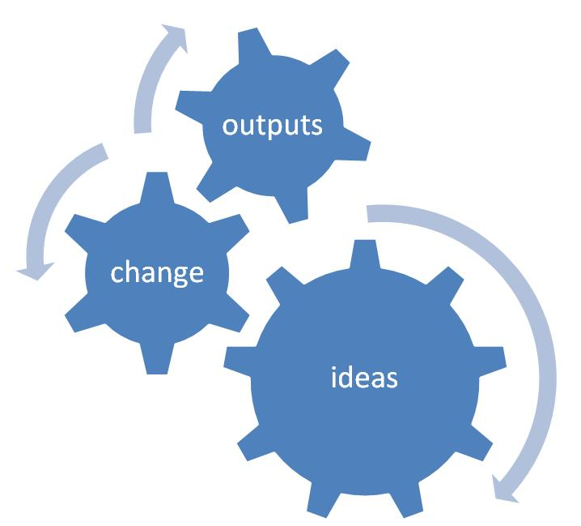
Community Plan Development
Be creative
Be flexible
Be resourceful
Considerations
Think non-traditional
Think innovation
Think outside the box
Notes:
One of the key elements of a mobility management plan is the use of non-traditional solutions. Be creative, flexible, and resourceful. Encourage the groups to make assumptions and create something different.
As the participants begin to develop their mobility management plan, encourage non-traditional thinking. Out-of-the-box is the emphasis, but don’t throw away what already works. At this point the instructor will introduce the activity.

Slide 127
Community Plan Components
Vision
Stakeholders, BORPSAT
Service solutions
Demand estimates, including unmet demand
Budgets for operation
Revenue and funding sources
Marketing and advertising (promotion)
“Sales plan” for community, agency, politicians, etc.

Slide 128
Learning Activity 4
Review the case study at the back of your module
Vision
BORPSAT
General plan to improve mobility
Notes:
This will be the case study class participants will use to design a Community Plan. Divide the participants into small groups of 4-5 people. They are then given the theoretical small town case study and asked to develop an action plan. This should take no more than 20 minutes, and then 30 minutes for the reports.

Slide 129
Module 5
Case Studies

Slide 130
Innovative Programs
Where is mobility management working?
Buffalo, NY
Florida
Washington State
Aiken, SC
COAST: Colfax, WA
State of Wisconsin
Metropolitan Detroit Region
Maricopa County, AZ
Notes:
The case studies above are discussed on the following pages.

Slide 131
Buffalo, NY
Private-for-profit
Maintenance for human service vehicles
Training human service agencies and drivers in central location
Medicaid brokerage for 2 counties
Brokerage software developed in-house
Notes:
Center for Transportation Excellence bought We Care. They realized there were in a tax-free zone and could receive tax credits and tax deferments. So, they did all this without federal funds!
Source: www.wecaretrans.com and www.cfte.org

Slide 132
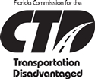
Florida
Statutory Chapter 427 – State legislation that requires coordinated transportation
Local Coordinating Board (LCB) – agency, customer, and political representatives
Community Transportation Coordinator (CTC)
All 67 counties participate
7 state agencies
Florida Commission for the Transportation Disadvantaged
7 members-at-large
Notes:
Source: www.dot.state.fl.us/CTD

Slide 133
Washington State
13 medical transportation districts
Brokers receive an administrative fee, and providers are paid by the State
Utilize different delivery systems
Medicaid: 33% bus pass, 25% taxi, and 18% volunteer

Slide 134
Aiken, SC
Lower Savannah Council of Governments
6 rural counties
2 mobility managers
Sharing vehicles > 300
Medicaid transformation site
Central clearing house
I & R (Information and Referral)
Contracting for services
MSAA site

Slide 135
COAST: Colfax, WA
Council on Aging and Human Services (Transportation Program)
23,000 square miles, 8 counties, and 2 states
General public and specialized transit, information and dispatch center, volunteers, vehicle loans, insurance pool, training broker, and school transportation
Direct service provider plus broker
Community vehicle program (volunteer operators)
Lead agency for vehicle acquisition
Notes:
Council on Aging & Human Services Transportation Program, COAST provides transportation in eight counties and two states. In Washington, COAST serves Whitman, Asotin, and Garfield counties. In Idaho, COAST serves Nez Perce, Idaho, Clearwater, Lewis, and Latah Counties.
Operates as a Medicaid Transportation Brokerage in Whitman, Asotin and Garfield Counties in Washington and is a Medicaid Transportation Provider in Idaho. People with Medicaid benefits, traveling to authorized medical services, can call COAST with a ride request. In most circumstances we can provide a variety of transportation options.
Has subcontractors in all areas of service to provide the lowest cost, most appropriate transportation for all categories of clients.
Provides a wide range of public transportation services for people who have no other means of transportation and/or cannot afford the cost of operating their own vehicle.
Offers hands-on specialized assistance to people with disabilities. Many of our transportation vehicles are wheelchair lift-equipped and meet the requirements of the Americans with Disabilities Act. All COAST vehicle operators have been professionally trained in passenger assistance techniques and are sensitive to the needs of individuals who need mobility assistance.
Has contractual relationships with two offices of Aging & Long Term Care and provides transportation for people sixty years of age and older to meal sites, medical appointments, shopping, social services, and other necessary services in Whitman County and several counties in Idaho.
Offers transportation services, training and technical assistance and consult services for many social service agencies and other nonprofit organizations.
Expands options for mobility by providing safe, affordable, accessible, coordinated and brokered transportation services.
This example includes the use of yellow school buses during off-peak hours.
Source: http://www.coa-hs.org/coast.htm

Slide 136
State of Wisconsin
Use 5316, 5317, and Supplemental Transportation Rural Assistance Program (STRAP) to fund 18 mobility managers (now 50+ mobility managers)
Located in Center for Independent Living, Community Action Partnership, aging offices, counties, community care organizations, etc.
All types of programs, car sales, repair, car pooling, volunteers, vouchers
Local decisions relative to services
Wisconsin DOT support, training, Google Groups sites
groups.google.com/group/wi-mobility-managers
groups.google.com/group/mobility-management-forum
Notes:
29 mobility managers throughout the state in 2008
16 hired through first New Freedom application cycle for projects implemented in 2008
9 funded by JARC/WETAP (Wisconsin Employment Transportation Assistance Program)
4 funded by STRAP (Supplemental Transportation Rural Assistance Program
Who employs mobility managers?
Aging and Disability Resource Centers/Departments and Commissions on Aging
Cities, Counties/Transit Commissions
United Way/Women’s Employment Center
Independent Living Centers
Community Action Coalitions/Programs/Service Agencies
Economic Opportunity Councils
Care management agencies
Development groups
Projects implemented in 2008
3 regional mobility management projects (one includes 11 counties)
10 car loan programs
7 new service projects
5 voucher programs
4 vehicle repair programs
3 car pool programs
3 rideshare programs
3 shuttle programs
3 travel training programs
3 volunteer driver program
**Note: The instructor should tell the participants that other mobility management Google sites exist.
Source: http://www.communityactionpartnership.com/

Slide 137
Metropolitan Detroit Region
Suburban Mobility Authority for Regional Transportation (SMART)
6 counties and 73 localities
Localities provide tailored services plus connections to regional transportation
Support functions include community forums, coordinated dispatching, preventive maintenance, joint capital purchases, and travel training
Localities provide financial support through local tax millage; SMART obtains federal and state funding
Notes:
SMART is required to get their millage renewed every 5 years. It has been renewed twice, and both times there was an increase in the percentage of approval. Management attributes that to flexibility given to communities and also to the communities being satisfied with the results.

Slide 138
Maricopa County, AZ
Mobility in the broadest sense
All aspects of mobility, not just transportation
Coordination is just a piece of mobility management, not the entire concept
25 recommendations (see back of module for complete list)
Notes:
Maricopa is one county where the “total” transportation issue of mobility is addressed. This is one application of mobility in it’s purest form.
**Note: See the complete list of Maricopa County, AZ recommendations at the back of the module.
Source: http://www.mag.maricopa.gov/pdf/Elderly-Mobility-Plan.pdf

Slide 139
Summary
Mobility management provides various models depending on each community’s needs
Many mobility management projects are located in rural areas, although urban models are becoming more popular

Slide 140
Module 6
The Mobility Manager and Mobility Management – Putting It All Together
Notes:
The mobility manager should always think of the customer first. What does the customer want? How can I best serve their need? Listen intently. You as a mobility manager also have to “sell” your vision. Not everyone will understand or even want to understand mobility management. It is your job as a mobility manager to create a vision that people want to follow and build on.
When you are performing your activities you will be searching in places you never dreamed would provide you more resources. Don’t be afraid to go into the unknown.

Slide 141
Learning Objectives
Discuss the skills and competencies of a mobility manager
Describe the types of knowledge a mobility manager must personify
List the job requirements of a mobility manager

Slide 142
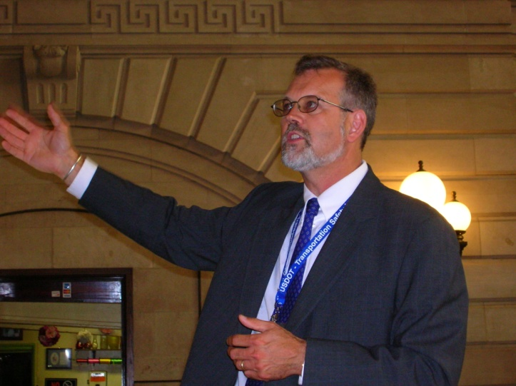
The Mobility Manager
Skills and competencies
Develop partnerships/ collaboration
Leadership
Creativity
Flexibility
Negotiations/ conflict resolution
Putting it all together
Notes:
A mobility manager should have many skills. Here are just a few. Let the participants add to the list. Read the screen and then ask for more from the class. Make a list on the flip chart. Look for entreprenual skills.
The role of the mobility manager is ever changing. Whenever you think you’ve got “IT”, “IT” changes. Don’t become complacent. Always search for new and better ways to connect people with places.
Interactivity – Ask: What skills do you think a mobility manager should possess? Write the answers on a flip chart. Did the participants mention ENTREPRENEUERSHIP?

Slide 143
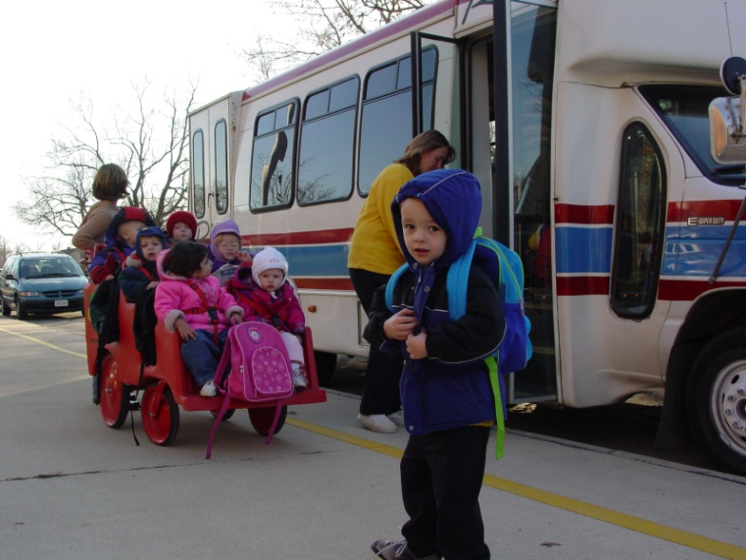
The Mobility Manager
Community knowledge
Resources
Needs
Partners
Consumer groups, customers
Be an advocate, be part of the community
Collaboration and partnership development
Customer focus
Notes:
Community – The instructor will emphasize the necessity of the mobility manager to have extensive community knowledge. This knowledge can be acquired by living in the community for an extended period of time, or by using people in the community who know the area.
The community needs are probably better defined than the resources. The needs are usually identified by some “specialty” group, such as local men’s and women’s associations. The needs are the first step in solving problems.
The mobility manager must be a one person advocate for creative efficient transportation services. Always be on the outlook for needs and resources. Always be ready to step in where others shy away.
The mobility manager must work to develop collaboration with other transportation and program managers. The mobility manager should always think of the customer first. What does the customer want? How can I best serve their need? Listen intently. You as a mobility manager also have to “sell” your vision. Not everyone will understand or even want to understand Mobility Management. It is your job as a mobility manager to create a vision that people want to follow and build on. When you are performing your activities you will be searching in places you never dreamed would provide you more resources. Don’t be afraid to go into the unknown.

Slide 144
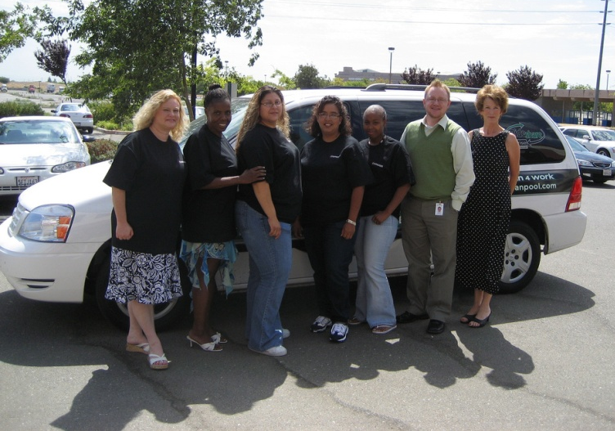
The Mobility Manager
Market demand knowledge
Elderly
Disabled
Workers
Students
Notes:
Market demand – The market demand knowledge is probably best found from the transit system, if there is one, or the local human service agency. The census is another source of market knowledge.
The mobility manager must have a good working plan to help identify the local demand and what part of the market is being met by existing resources. Also, the mobility manager should look at how could the market be met in a more productive manner.

Slide 145
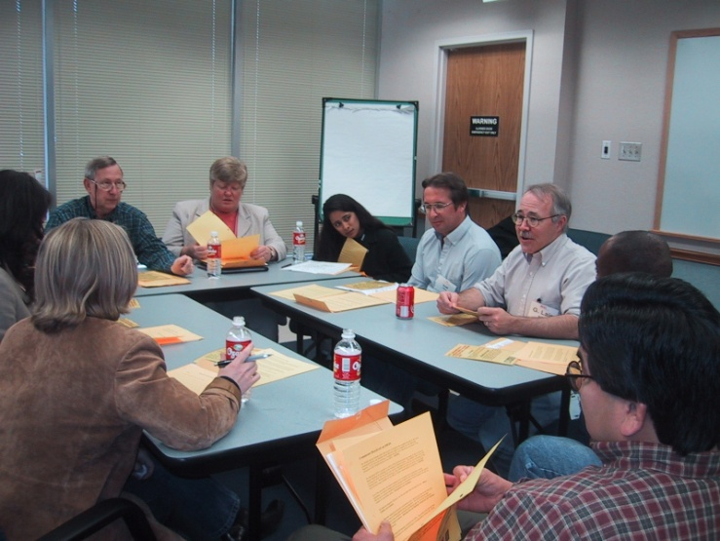
The Mobility Manager
Resource knowledge
Coordinated Plan
Local transit plan
Medicaid plan
Community meetings
Council of Governments (COG)
Metropolitan Planning Organization (MPO)
Notes:
Resource – The identification of resources is necessary to the successful implementation of the Coordinated Plan. The resources include:
Providers
Community programs, both social service and private
The mobility manager must have a good working plan to help identify the local demand and what part of the demand is being met by existing resources. Also, the mobility manager should look at how could the demand be met in a more productive manner.

Slide 146
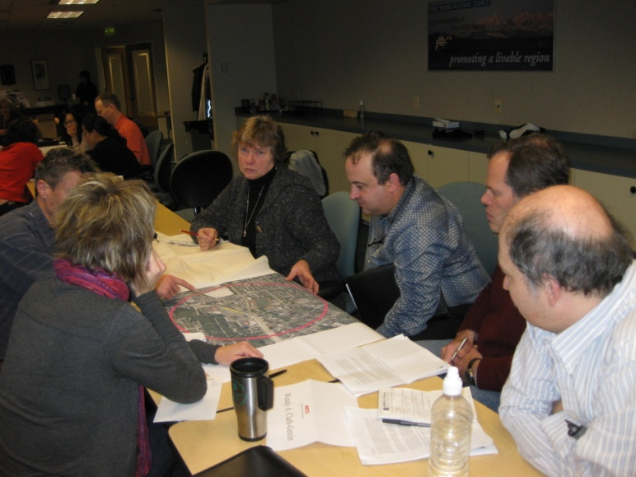
The Mobility Manager
Political knowledge
Stakeholders
BORPSAT
Mayor/Council
Bankers
Chamber of Commerce
Notes:
It is important for the mobility manager to be aware of the political impacts of various scenarios. The political problems are sometimes more difficult to solve than the technical. Political problems include the local, State, and Federal Governments where program emphasis may be different. The program emphasis affects funding, so the mobility manager might have to be creative in the use of funds for “associated” activities. Don’t do anything illegal, but remember that forgiveness is easier to get than approval.

Slide 147
Job Descriptions
Lower Savannah COG – Lowcountry RTA
Louisville, KY – TARC
North Shore, MA – Workforce Investment Board
Additional examples
http://web1.ctaa.org/webmodules/webarticles/anmviewer.asp?a=372&z=78
Click Tools
Click Mobility Manager Job Descriptions
See Appendix for Job Descriptions
Notes:
Mobility management job descriptions are starting to appear. Review the job requirements with the participants.
Source: http://web1.ctaa.org/webmodules/webarticles/anmviewer.asp?a=372&z=78

Slide 148
Create a Vision
Look under ALL the rocks

Slide 149
Willing to Take a Risk?
Ability to stand and lead
Flexibility
Advocacy
Think the unthinkable!
No fear of failure
Notes:
Many public employees have a fear of failure, because their job could be on the line. Mobility management calls for all to be fearless.
You as a mobility manager must be strong and lead people where they might not want to go. This is one of your challenges to bring staff, politicians, users, and the communities along the road of mobility management.
An important attribute of a mobility manager is flexibility. Be willing and able to change and balance many balls in the air at the same time. Multi-tasking is the norm.
The mobility manager will be a strong advocate for improving the transportation situation in local communities. The mobility manager can also provide guidance and support at the State level.
Whenever you are thinking of solutions, think the unthinkable. You might think that a certain provider is not one of the better providers in the system. This could be true, but that provider also has ideas that you could benefit from. Talk to everyone.

Slide 150
Mobility Management
Promotion, enhancement, and facilitation of access to transportation services
Support for short term management activities to plan and implement coordinated services
Support of state and local coordination policy bodies and councils
Operation of transportation brokerages to coordinate providers, funding agencies, and customers
Notes:
Mobility management is intended to build coordination among existing public transportation providers and other transportation service providers, with the result of expanding the availability of service.
Mobility management activities may include:
Promotion, enhancement, and facilitation of access to transportation services
Support for short term management activities to plan and implement coordinated services
Support of state and local coordination policy bodies and councils
Operation of transportation brokerages to coordinate providers, funding agencies, and customers

Slide 151
Mobility Management
Provision of coordinated services
Travel training, trip planning, and travel navigator activities for customers
Development and operation of one-stop transportation call centers to coordinate transportation information
Operational planning for the acquisition of IT technologies
20% match for federal funds can be federal money as long as it’s not DOT
Notes:
Mobility management activities:
Provision of coordination services
Travel training, trip planning, and travel navigator activities for customers
Development and operation of one-stop transportation traveler call centers to coordinate transportation information
Operational planning for the acquisition of intelligent transportation technologies

Slide 152
Challenges
Dare to be creative
Don’t give up
Try the unknown
Push the limits
Search for the untried
Be an advocate
Think creatively
Be intuitive
Notes:
These three challenges are the basis for change. There will be many obstacles, but a good, dedicated, and committed mobility manager will persevere.

Slide 153
Guess Who?
Notes:
Find inspiration from great achievers. In 1975, George Lucas had a vision for a new film he wanted to make – Star Wars. However, Hollywood didn’t take George seriously. They told him, the idea for Star Wars was technically impossible and couldn’t be done, but he was not about to give up. John Dykstra, a studio executive, believed in Lucas’ vision. They worked together to design and build a studio (Industrial Light and Magic – ILM) and began inventing and assembling technology needed to make the impossible possible.
Star Wars was a personal vision for Lucas, “If you want to be successful in a particular field of endeavor, I think perseverance is one of the key qualities. It’s very important that you find something that you care about, that you have a deep passion for, because you’re going to have to devote a lot of your life to it. And you’re going to have to really be focused on it. And you’re going to have to overcome a lot of hurdles, a lot of people saying you can’t do it. And you’re going to have to take a lot of risks.” If Lucas had not believed Star Wars was possible, few of his other movies would have been made. For that matter, most of the influential and profitable movies of the last 20 years would have not been possible.
Source: Academy of Achievement interview with George Lucas, June 19, 1999, Washington, DC

Slide 154
Wrap-up and Evaluations

